Slide 1


DEPARTMENT OF COMPUTER SCIENCE & ENGINEERING
CST463 - WEB PROGRAMMING
27 July 2024
Notes:
Welcome the participants to the program.
Introduce yourself and briefly summarize your experience at EY and your interest in presenting at Welcome to EY.
Have co-facilitators, if present, introduce themselves and provide background information.
State the following to help participants understand the context of Welcome to EY:
This course was designed for all ranks around the globe. It provides you with foundational knowledge that will help to explain our culture, our processes and how we go to market.
However, your service line will provide the specifics about your role and your job.
As an organization, we want to invest in you, give you consistent content globally, let you meet other new hires across service lines and meet some of our leaders.

Slide 2


CST463 - WEB PROGRAMMING
St . Joseph’s College of Engineering and Technology, Palai

Slide 3
Module 2 (CO2, Cognitive Knowledge Level: Apply)
(CSS, JavaScript) Introduction to Stylesheets : Introduction to CSS-Basic syntax and structure-Inline Styles, Embedded Style Sheets, Conflict Resolution, Linking External Style Sheets-Exploring CSS Selectors-Properties, values, Positioning Elements: Absolute Positioning, Relative Positioning - Backgrounds-List Styles-Element Dimensions- Table Layouts-Box Model and Text Flow-div and span -Basics of Responsive CSS, Media port & Media Queries.
Introduction to JavaScript : Introduction to Scripting- Programming fundamentals of JavaScript -Obtaining User Input with prompt Dialogs-Arithmetic-Decision Making -Control Statements - Functions -Arrays -Objects -Document Object Model (DOM) -Form processing

Slide 4
Introduction to Stylesheets

Slide 5
Introduction to CSS3
Cascading Style Sheets 3 (CSS3) that allows you to specify the presentation of elements on a web page (e.g., fonts, spacing, sizes, colors, positioning) separately from the document’s structure and content (section headers, body text, links, etc.).
CSS is a set of rules for displaying markup content.
CSS made the Separation of structure from presentation
multiple style sheets can be applied to the same Web page
Same style sheet can be applied to the multiple Web page
Cascading:
Display rules “cascade” down
The most specific rule is used
Styles Sheet: consists of Rules which are created as styles

Slide 6
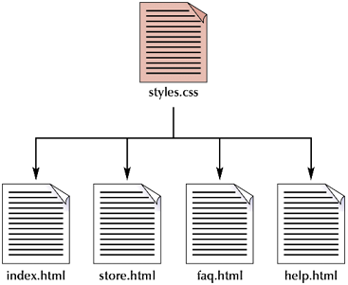
Advantages of CSS3
Saves time
Easy to change
Keep consistency(always behave in the same way)
more control over layout
Use styles with JavaScript => DHTML
create a common format for all the Web pages

Slide 7
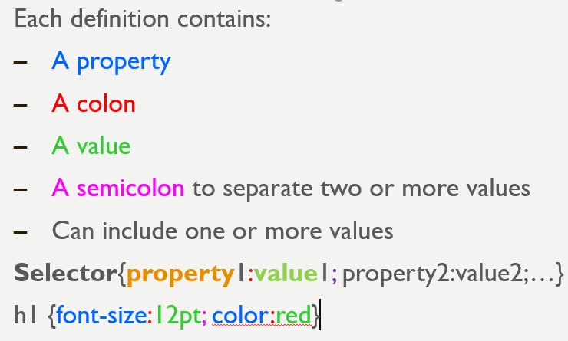
Types of CSS
Inline style sheet
The style properties are added within the HTML tag itself
Embedded style sheet
The set of style properties are embedded within the HTML document
External style sheet
Common set of style properties are applied to all the web pages from an external .css file.

Slide 8
Order of Precedence of Style Sheet
Inline style sheets(lowest level)
Embedded/Document Level sheets
External style sheets(highest Level)
Inline Style sheets have precedence over document style sheets which have precedence over external style sheet.
When using multiple styles that conflict, which will be displayed?
Order:
Inline style sheet
Embedded style sheet
External style sheet
Browser default

Slide 9
Style Specification Format
Inline Style
Style=“property0:value0;property1:value1;
………
propertyZ:valueZ;”
Document Level
<style type=“text/css”>
rule_list
</style>
Each style rule in a rule list has two parts
Selector—the tag or tags affected by the rule.
List of property/value pairs
Selector { property_1: value_1; property_2: value_2:… property_n: value_n;}

Slide 10
Style Specification Format
External Style sheet
<link href=URL rel=“relation_type” type=“link_type”>
URL is the file.css
Relation_type=“stylesheet”
Link_type=“text/css”
Do not include <style> tags
Save the document as filename.css

Slide 11
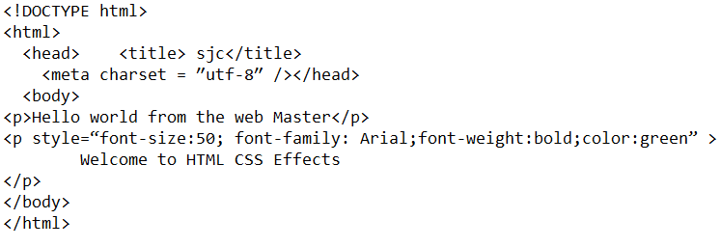
Inline styles
Add styles to each tag within the HTML file
Use it when you need to format just a single section in a web page
style information is directly attached to the HTML elements they affect
Attribute style,followed by a colon and a value
<h1 style=“color:red; font-family: sans-sarif”>India is my country</h1>

Slide 12
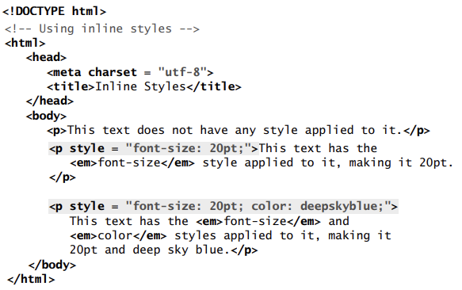
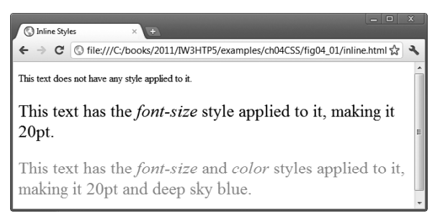
Inline styles

Slide 13
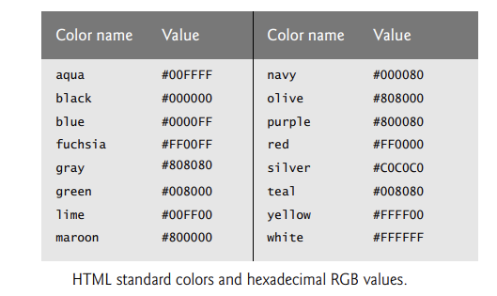
Inline styles
Attribute style specifies an element’s style. Each CSS property (font-size in this case) is followed by a colon and a value. the two properties, font-size and color are separated by a semicolon.
set the given paragraph’s color to deepskyblue. Hexadecimal codes may be used in place of color names.
Figure contains the HTML standard color set.
A complete list of HTML standard and extended colors at www.w3.org/TR/ css3-color/

Slide 14
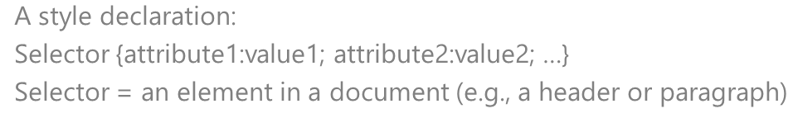
Embedded / internal/Document level
A style is applied to the entire HTML file.Use it when you need to modify all instances of particular element (e.g., h1) in a web page
Example
<style type=“text/css”>
h1 {color:red; font-size:20;font-family:monospace}
</style>
<head>
<title>Embedded Example</title>
<style type=“text/css”>
Style declarations
</style>
</head>

Slide 15
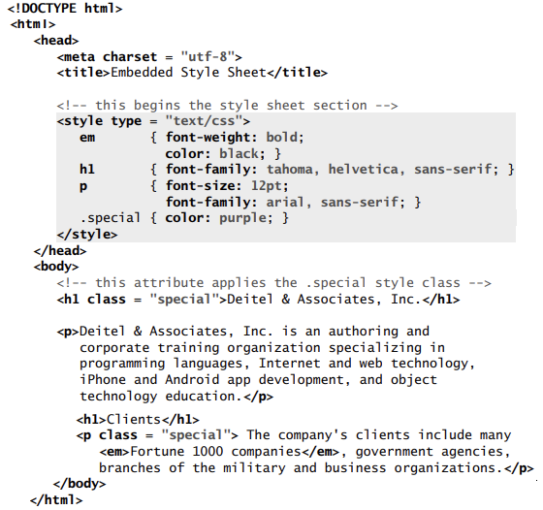
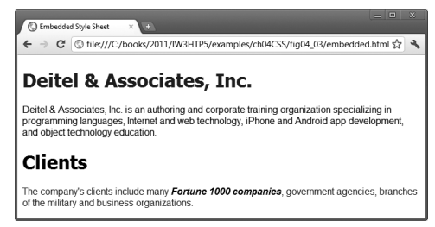
Embedded / internal/Document level

Slide 16
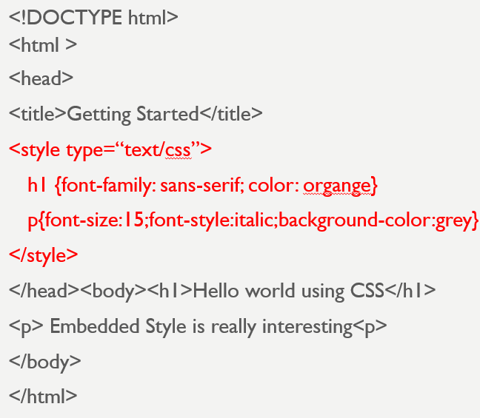
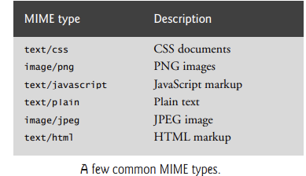
Embedded / internal/Document level
Styles placed in the head apply to matching elements wherever they appear in the body.
The style element’s type attribute specifies the MIME (Multipurpose Internet Mail Extensions) type that describes the style element’s content.
CSS documents use the MIME type text/css

Slide 17
External style sheets
Style sheets are a convenient way to create a document with a uniform theme.
With external style sheets (i.e., separate documents that contain only CSS rules), you can provide a uniform look and feel to an entire website (or to a portion of one).
You can also reuse the same external style sheet across multiple websites.
Different pages on a site can all use the same style sheet. When changes to the styles are required, you need to modify only a single CSS file to make style changes across all the pages that use those styles. This concept is sometimes known as skinning.
While embedded style sheets separate content from presentation, both are still contained in a single file, preventing a web designer and a content author from conveniently working in parallel.
External style sheets solve this problem by separating the content and style into separate files

Slide 18
External style sheets
An external style sheet is a .css file containing the style definition (declaration)
Use it when you need to control the style for an entire web site
Example
h1, h2, h3, h4, h5, h6 {color : red; font-family : sans-serif}
Save this in a new document using a .css extension
Creating an External Style Sheet
Open a new blank document in Notepad
Type style declarations
h1 {color:red; font-family:sans-serif;}
Do not include <style> tags
Save the document as filename.css
Linking to Style Sheets
Open an HTML file
Between <head> and </head> add
<link href=URL rel=“relation_type” type=“link_type”>
URL is the file.css
Relation_type=“stylesheet” and Link_type=“text/css”
Save this file and the .css file in the same web server directory

Slide 19
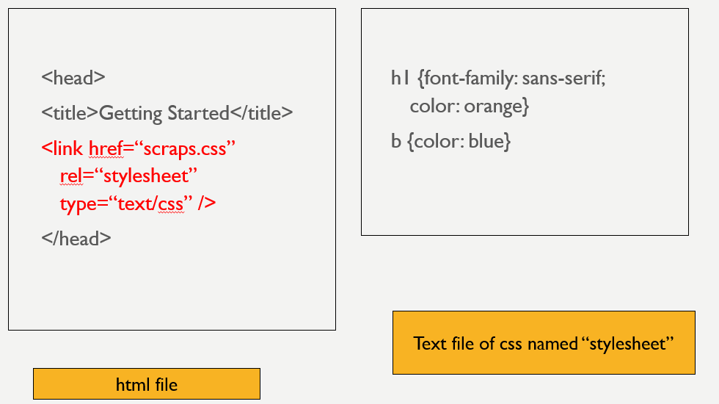
Linking External style sheets

Slide 20
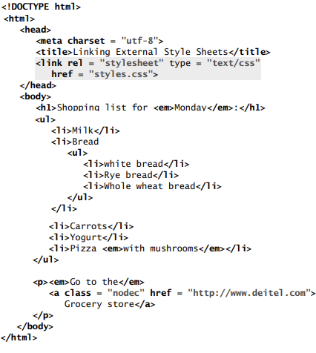
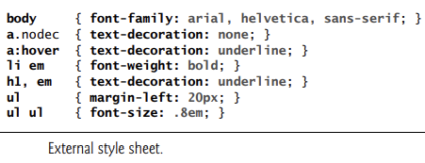
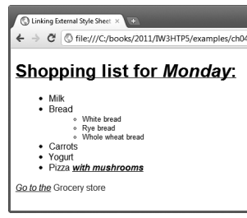
Linking External style sheets

Slide 21
Conflict Resolution

Slide 22
Conflicting styles
Styles may be defined by a user, an author or a user agent.
User →User is a person viewing your web page,
Author → Author is the person who writes the document and the
User Agent →It is the program used to render and display the document (e.g., a web browser).
Styles cascade (and hence the term “Cascading Style Sheets”), or flow together, such that the ultimate appearance of elements on a page results from combining styles defined in several ways.
Styles defined by the user take precedence over styles defined by the user agent.
Styles defined by authors take precedence over styles defined by the user.
Most styles defined for parent elements are also inherited by child (nested) elements

Slide 23
Conflict resolution
There are certain properties that you don’t want to be inherited.
For example, the background-image property allows you to set an image as the background of an element.
If the body element is assigned a background image, we don’t want the same image to be in the background of every element in the body of our page. Instead, the background-image property of all child elements retains its default value of none.
There are some rules for resolving conflicts between styles defined for elements and styles inherited from parent and ancestor elements
Properties defined for child and descendant elements have a higher specificity than properties defined for parent and ancestor elements.
Conflicts are resolved in favor of properties with a higher specificity, so the child’s styles take precedence

Slide 24
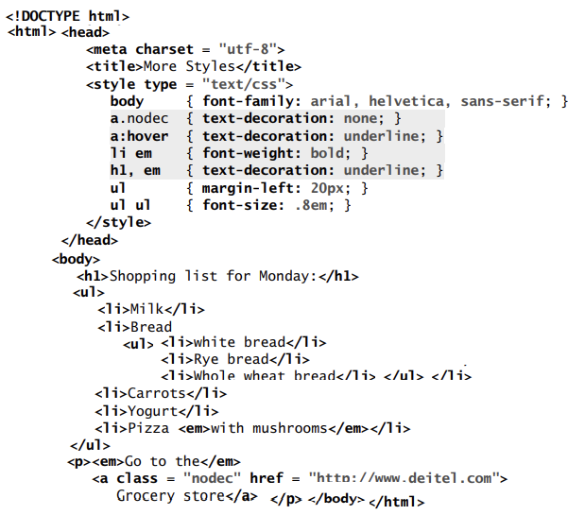
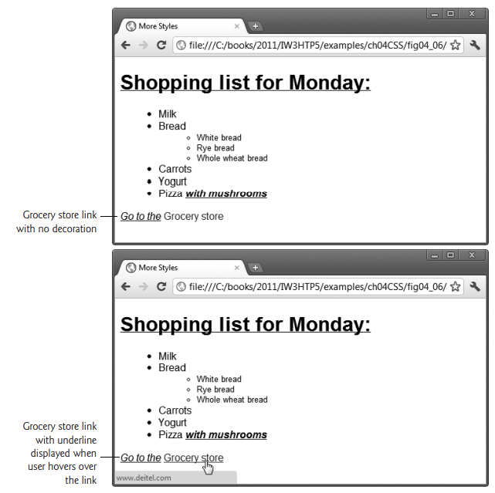

Slide 25
Style Sheets-Exploring CSS Selectors

Slide 26
Exploring CSS Selectors
CSS selectors are used to "find" (or select) the HTML elements you want to style.
There are six different selector forms
Simple selector
Class selector
Generic selector
Id selector
Universal selector
Pseudo classes

Slide 27
Exploring CSS Selectors- Simple selector
Simple selector form is a list of style rules, and property values in the rule apply to all occurrences of the all of the named element
The selector is a tag name or a list of tag names, separated by commas
Ex) h1, h3 { font-size: 24pt ;}
h2 { font-size: 20pt ;}
Contextual selectors: Selectors can also specify that the style should apply only to elements in certain positions in the document
Ex) selector applies its style to the content of italic elements that are descendants of bold elements in the body of the document.
body b i {font-size: 24pt ;}
Also called as descendant selectors.

Slide 28
Exploring CSS Selectors- class selector
Used to allow different occurrences of the same tag to use different style specifications.
HTML and XHTML require each id be unique– therefore an id value can only be used once in a document.
You can mark a group of elements with a common identifier using the class attribute. <element class=“class”> … </element>
A style class has a name, which is attached to the tag‘s name with a period.
p.ques{property-value list}
p.ans {property-value list}
<p class = “ques"> What is WWW?</p>
<p class = “ans"> WWW is World wide web,an information repository which can be accessed over internet</p>

Slide 29
Exploring CSS Selectors- class selector -Example
<!DOCTYPE html>
<html lang = ″en″> <head> <title> sjc</title> <meta charset = ″utf-8″ />
<style type = "text/css">
p.regtext {font-family: Times; font-size: 14pt; width: 800px}
p.abstext { position: absolute;top: 125px; left: 50px; font-family: Times; font-size: 24pt; font-style: italic; width: 500px}
</style> </head> <body>
<p class = "abstext"> APPLES ARE GOOD FOR YOU </p>
<p class = "regtext"> Apple is the common name for any tree of the genus Malus, of the family Rosaceae. Apple trees grow in any of the temperate areas of the world. Some apple blossoms are white, but most have stripes or tints of rose. Some apple blossoms are bright red. Apples have a firm and fleshy structure that grows from the blossom. The colors of apples range from green to very dark red. The wood of apple trees is fine-grained and hard. </p>
<p class = "abstext"> ORANGES ARE GOOD IN SUMMER </p>
<p class = "regtext"> Oranges the common name for any tree of Orange. trees grow in any of the temperate areas of the world. Some orangaes blossoms are white, but most have stripes or tints of rose. </p>
</body>
</html>

Slide 30
Generic Selector
A generic class can be defined if you want a style to apply to more than one kind of tag.
A generic class must be named, and the name must begin with a period without a tag
Example: .really-big { … }
<h1 class = "really-big"> SJCET ADMISSION</h1>...
<p class = "really-big"> SJCET BTECH ADMISSION 2022… </p>
<h2 class = "really-big"> SJCET BHRM ADMISSION 2022… </h2>
<h3 class = "really-big"> SJCET PG ADMISSION 2022… </h3>

Slide 31
Generic Selector
<!DOCTYPE html><html lang = ″en″> <head> <title> sjc</title> <meta charset = ″utf-8″ />
<style type = "text/css">
.regtext {font-family: Times; font-size: 14pt; width: 800px}
.admstext { position: absolute;top: 125px; left: 50px; font-family: Times; font-size: 24pt; font-style: italic; width: 500px}
</style>
</head>
<body>
<h1 class = “admstext"> SJCET ADMISSION</h1>.
<p class = "regtext">SJCET structure that grows from the blossom. Minority catholic institution .provides Btech and MTECh courses</p>
<p class = “admstext"> SJCET BTECH ADMISSION 2022… </p>
<p class = "regtext">SJHMCT hotel management institution . Minority catholic institution .provides BHRM courses</p>
<h2 class = “admstext"> SJCET BHRM ADMISSION 2022… </h2>
<h3 class = “admstext"> SJCET PG ADMISSION 2022… </h3>
<p class = "admstext"> PG courses MTECH,MBA,MTECH available at SJCET</p>
</body> </html>

Slide 32
Id Selector
An id selector allow the application of a style to one specific element.
Style specified in the id selector applies to the element with the given id.
To create an ID for a specific tag, use the property:
<tag id=“id_name”>
To apply a style to a specific ID, use:
#id_name {style attributes and values}
The general form of an id selector is as follows :
#specific-id {property-value list}
Example:
#section14 {font-size: 20} specifies a font size of 20 points to the element
<h2 id =“section14”> Alice in wonderland</h2>

Slide 33
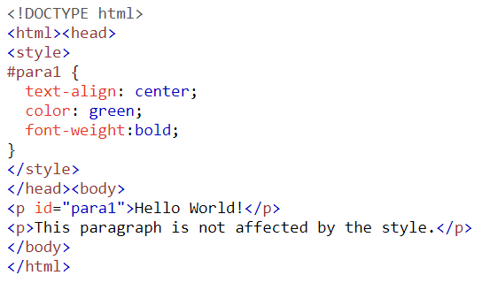
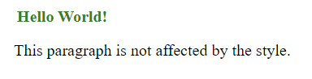
Id Selector

Slide 34
Universal Selector
The universal selector, denoted by an asterisk(*), which applies style to all elements in the document.
For example: *{color: red;} makes all elements in the document red. Is not often useful.

Slide 35
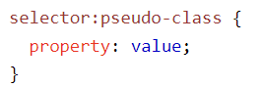
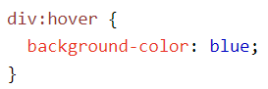
Pseudo Classes
A pseudo-class is used to define a special state of an element.
For example, it can be used to:
Style an element when a user moves the mouse over it
Style visited and unvisited links differently
Style an element when it gets focus
Pseudo classes are styles that apply when something happens, dynamically instead of simply displaying the target element
Names of pseudo classes begin with colons hover classes apply when the mouse cursor is over the element focus classes apply when an element has focus i.e. the mouse cursor is over the element and the left mouse button is clicked
These two pseudo classes are supported by FX2 but IE7 supports only hover

Slide 36
Pseudo classes
<html >
<head> <title> Style for Input Type Text </title>
<style type = "text/css">
input:hover {color: red;border-top:dotted;}
input:focus {color: green;border-color:yellow;}
</style>
</head>
<body>
<form action = "">
<p> Your name: <input type = "text" /> </p>
</form>
</body>
</html>

Slide 37
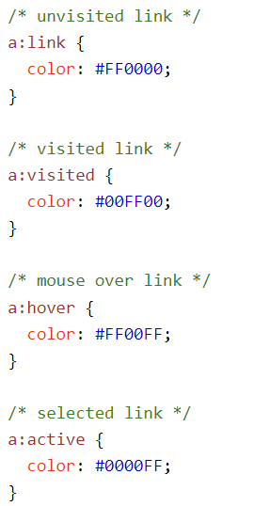
Anchor Pseudo Classes
Links can be displayed in different ways.
We can modify the way hyperlinks appear by creating style rules modifying the <a> tag with the following “pseudo-classes”:
link
visited
hover
active
a:link {color:#0000ff}
a:visited {color: #00ff00}
a:hover {color:fuschia; font-weight:bold}
a:active {font-size:30pt}

Slide 38
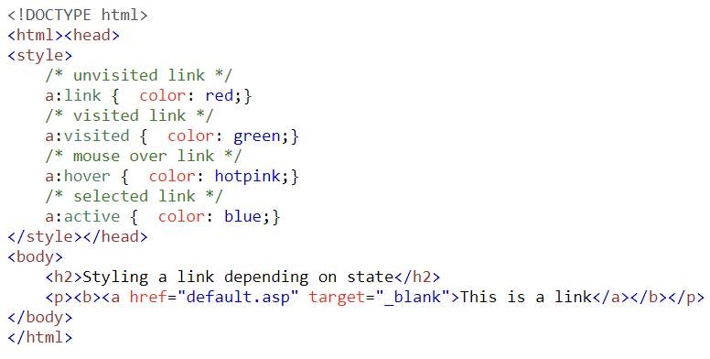
Anchor Pseudo Classes

Slide 39
CSS Properties - values
CSS properties are the styles used on specified selectors.
They are written before values in the CSS ruleset and are separated from property values by a colon.
Different HTML selectors and elements have different properties.
Some properties are universal and can be used on every selector.
Others work only on specific selectors and under particular conditions
There are many properties and their values for HTML selectors.
There are 520 distinct property names from 66 technical reports and 66 editor's drafts.
These properties are common because they are frequently used in all CSS documents and can be applied to different selectors.
One unique thing about properties is that they have more than one value attached to them.

Slide 40
CSS Property
CSS properties are the styles used on specified selectors.
five common properties to work with
List properties
Font properties
Border properties
Text properties
Color Properties
CSS VALUES
Values are written immediately after the colon that separates them from CSS properties.
CSS values aren't just text; they come in different forms
Text
URLs, units, measurements, integers, strings, inherit, auto, none, etc.

Slide 41
CSS VALUES
Values are written immediately after the colon that separates them from CSS properties.
CSS values aren't just text; they come in different forms
Keywords property values are used when there are only a few possible values and they are predefined (not case sensitive)
Eg: small, large, medium.
Number values can be integer or sequence of digits with decimal points and a + or – sign.
Length value are specified as number values that are followed immediately by a two character abbreviation of a unit name.
There can be no space between the number and the unit name. px for pixels, pt for points, pc for picas (12 points) , in for inches, cm for centimeters, mm for millimeters,

Slide 42
CSS VALUES
Percentage - just a number followed immediately by a percent sign: eg: font size set to 85% means new font size will be 85% of the previous font size value.
URL values: URL property values use a form that is slightly different from references to URLs in links.
url(protocol://server/pathname)
No space should be left between URL and the left parenthesis.
Colors : Color name rgb(n1, n2, n3).
Hex form: #B0E0E6 stands for powder blue color.

Slide 43
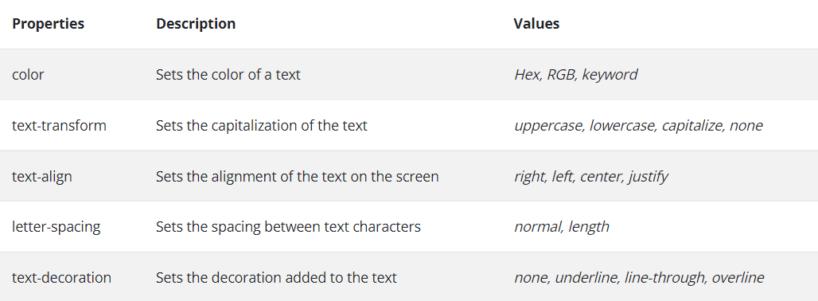
CSS Property- values-TEXT properties

Slide 44
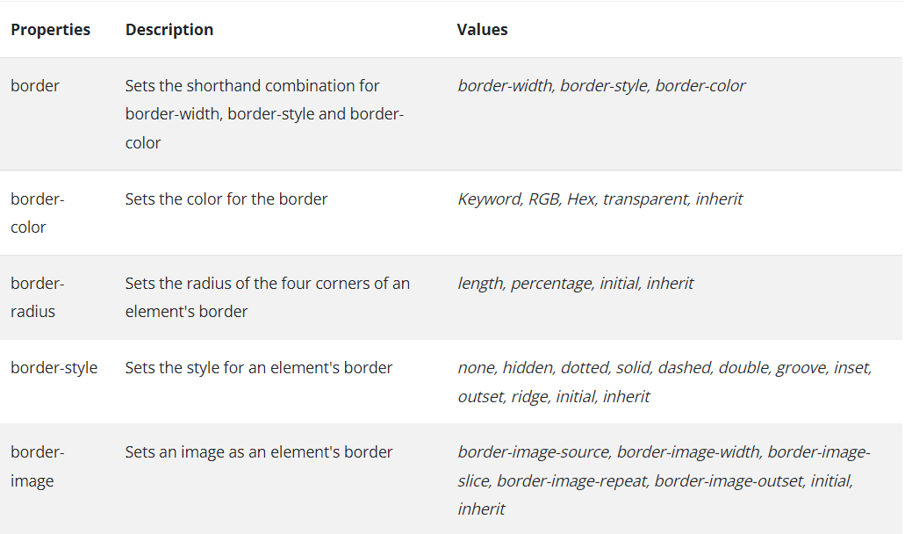
CSS Property- values-Border properties

Slide 45
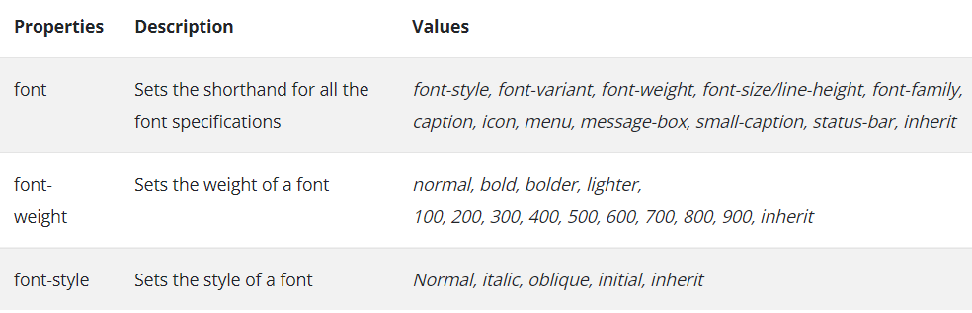
CSS Property- values-Font properties
The font-family property is used to specify a list of font name.The browser will use the first font in the list that it supports.
font-family: Arial, Helvetica, Courier
Generic fonts: They can be specified as the font family value for example :serif, sans-serif, cursive, fantasy, and monospace (defined in CSS).
If a font name that has more than one word, it should be single-quoted Eg: font-family: ‘Times New Roman‘

Slide 46
CSS Property- values-Font properties
Font Shorthand
If more than one font property is to be specified than the values may be stated in a list as the value of the font property .
Eg: font: bold 24pt ‘Times New Roman‘ Palatino Helvetica
The order which browser follows is last must be font name, second last font size and then the font style, font variant and font weight etc can be in any order but before the font size and names.
Font-size -Possible values: a length number or a name, such as smaller, xx-large, medium , large etc.
Font-variant -The default value of the font-variant property is normal, can be set to small-caps to specify small capital characters.
Font-style -The property is most commonly used to specify italic,
Font-weight -The property is used to specify the degree of boldness.
Text Decoration-line-through , overline , underline, none
Text Spacing: letter spacing , word spacing , line-height

Slide 47
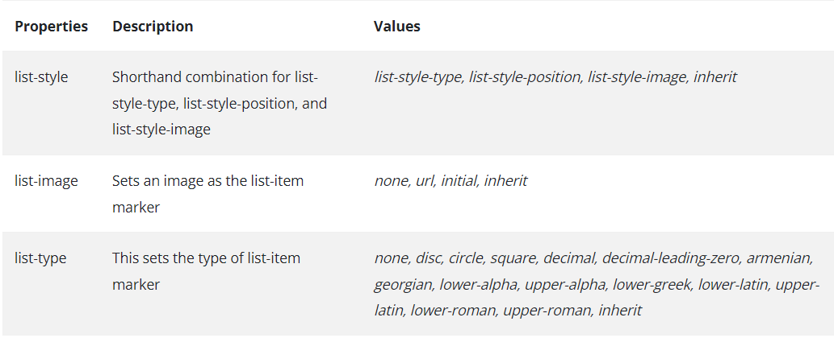
CSS Property- values-List properties

Slide 48
CSS Property- values-List properties
It is used to specify style of bullets or sequencing values in list items.
The list-style-type of Unordered lists can be set to disc,circle,square or none.
Bullet can be a disc (default), a square, or a circle
<li style = "list-style-type: circle">BTECH </li>
Could use an image for the bullets in an unordered list.
Example:
<li style = "list-style-image: url(book.jpg)">

Slide 49
CSS Property- values-List properties
When ordered lists are nested, it is best to use different kinds of sequence values for the different levels of nesting
Decimal Arabic numerals 1, 2, 3, 4
upper-alpha Uc letters A, B, C, D
lower-alpha Lc letters a, b, c, d
upper-roman Uc Roman I, II, III, IV
lower-roman Lc Roman i, ii, iii, iv
<style type = "text/css">
ol {list-style-type: upper-roman;}
ol ol {list-style-type: upper-alpha;}
ol ol ol {list-style-type: decimal;}
</style>

Slide 50
CSS Property- values-color properties
color –specify the foreground color of html elements
color:red
background-color→set the background color of an element
background-color:grey
Web Palette contains , one of 16 million different colors
A set of 16 generic colors that are guaranteed to be displayable
Names for some:
blue, red, green, pink
Hexadecimal
#0000FF, #FF0000, #00FF00, #FF3399
RGB
rgb(0,0,255), rgb(255,0,0), rgb(0,255,0)
RGB%
rgb(0%,0%,100%), rgb(100%,0%,0%)

Slide 51
CSS Property- values-other properties
1.text-align property has the possible values, left (the default), center, right, or justify.
we want text to flow around another element - the float property.
2. float property has the possible values, left, right, and none (the default).
Float property is used to specify that text should flow around some element.
3. text-indent property used to indent the first line of a paragraph

Slide 52
CSS Property- values-Background
CSS provides control over the backgrounds of block-level elements.
CSS can set a background color or add background images to HTML5 element
background-color→set the background color of an element
background-color:grey
The background-image property is used to place an image in the background of an element Repetition can be controlled.
Background image can be replicated to fill the area of the element. This is known as tiling.
background-repeat property possible values:repeat (default), no-repeat, repeat-x, or repeat-y
background-position property. Possible values: top, center, bottom, left, or right.

Slide 53
CSS Property- values-Example
<html><head> <title> sjc</title><meta charset = “utf-8” />
<style type = "text/css">
body { background-color:grey;background-image:url("agriculture.jfif");background-repeat:repeat-y;
background-position:center; }
Img {float:left; }
</style> </head> <body>
<h1> SJCET ADMISSION</h1>.
<img src="alogo.jfif"/><p>SJCET structure that grows from the blossom. Minority catholic institution .provides Btech and MTECh courses</p>
<p > SJCET BTECH ADMISSION 2022… </p>
<p >SJHMCT hotel management institution . Minority catholic institution .provides BHRM courses</p> <h2 > SJCET BHRM ADMISSION 2022… </h2>
<h3 > SJCET BHRM ADMISSION 2022… </h2><h3 > SJCET PG ADMISSION 2022… </h3>
<p> PG courses MTECH,MBA,MTECH available at SJCET</p>
</body> </html>

Slide 54
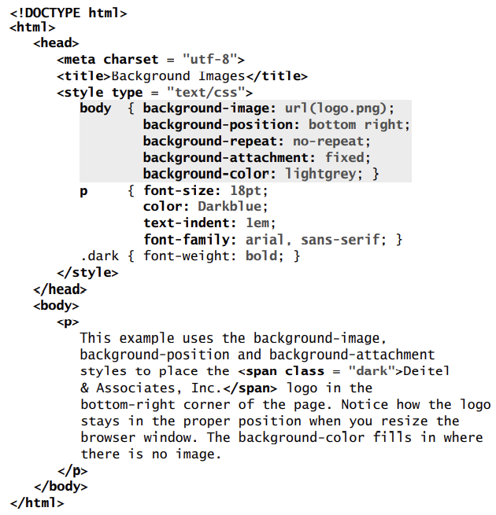
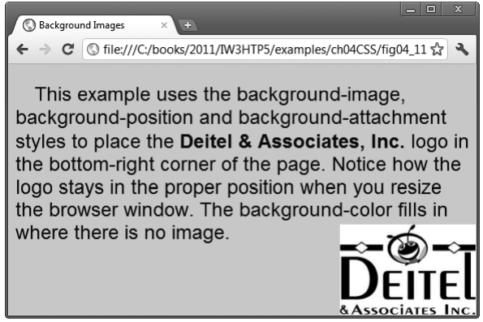

Slide 55
CSS Property- values-Background
background-image Property
The background-image property specifies the image URL for the image logo.png in the format url(fileLocation).
You can also set the background-color property in case the image is not found
background-position Property
The background-position property places the image on the page. The keywords top, bottom, center, left and right are used individually or in combination for vertical and horizontal positioning.
For example, to position the image as horizontally centered (positioned at 50 percent of the distance across the screen) and 30 pixels from the top, use

Slide 56
CSS Property- values-Background
background-attachment
fixed Property The next property setting, background-attachment: fixed , fixes the image in the position specified by background-position. Scrolling the browser window will not move the image from its position.
The default value, scroll, moves the image as the user scrolls through the document.
background-repeat Property
The background-repeat property controls background image tiling, which places multiple copies of the image next to each other to fill the background.
Here, we set the tiling to no-repeat to display only one copy of the background image.
Other values include repeat (the default) to tile the image vertically and horizontally, repeat-x to tile the image only horizontally or repeat-y to tile the image only vertically.
text-indent property to indent the first line of text in the element by a specified amount, in this case 1em.
font-style property formats text is the font-style property, which allows you to set text to none, italic or oblique

Slide 57
Positioning Elements: Absolute Positioning, z-index
The CSS position property is used to set the position for an element
CSS introduced the position property, which gives you greater control over how document elements are displayed
The position property specifies the type of positioning method used for an element.
Elements are then positioned using the top, bottom, left, and right properties. However, these properties will not work unless the position property is set first.
They also work differently depending on the position value.

Slide 58
Positioning Elements: Absolute Positioning, z-index
Absolute Position: An element with position: absolute; will cause it to adjust its position with respect to its parent. If no parent is present, then it uses the document body as parent.
position: absolute;
Relative Position: Setting the top, right, bottom, and left properties of an element with position: relative; property will cause it to adjust from its normal position. The other objects or elements will not fill the gap
The element that is set to relative position can be shifted with respect to other elements in the document. The element is shifted using top, right, bottom, and left properties

Slide 59
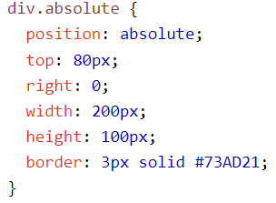
Positioning Elements: Absolute Positioning, z-index
An element with position: absolute; is positioned relative to the nearest positioned ancestor (instead of positioned relative to the viewport, like fixed).
Note: Absolute positioned elements are removed from the normal flow, and can overlap elements.

Slide 60
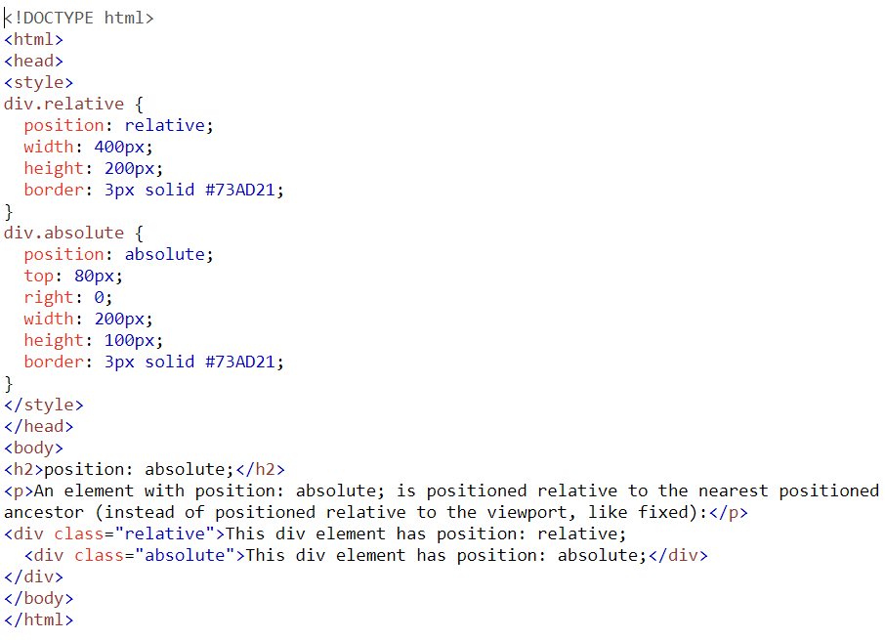
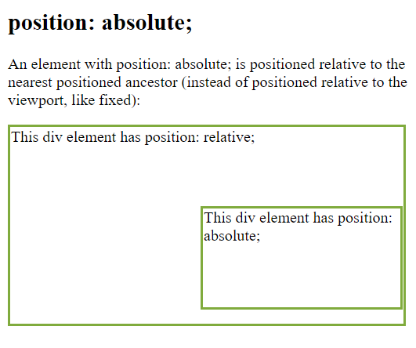

Slide 61
<!DOCTYPE html> <html> <head>
<meta charset = "utf-8">
<title>Relative Positioning</title>
<style type = "text/css">
p { font-size: 1.3em;
font-family: verdana, arial, sans-serif; }
span { color: red;font-size: .6em;height: 1em; }
.super { position: relative;top: -1ex; }
.sub { position: relative;bottom: -1ex; }
.shiftleft { position: relative;left: -1ex; }
.shiftright {position: relative;right: -1ex; }
</style> </head>
<body>
<p>The text at the end of this sentence <span class = "super">is in superscript</span></p>
<p>The text at the end of this sentence <span class = "sub">is in subscript</span></p>
<p>The text at the end of this sentence<span class = "shiftleft">is shifted left</span></p>
<p>The text at the end of this sentence<span class = "shiftright">is shifted right</span></p> </body> </html>

Slide 62
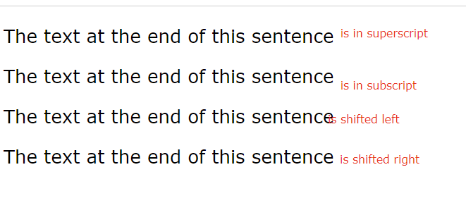
Positioning Elements:Relative Positioning

Slide 63
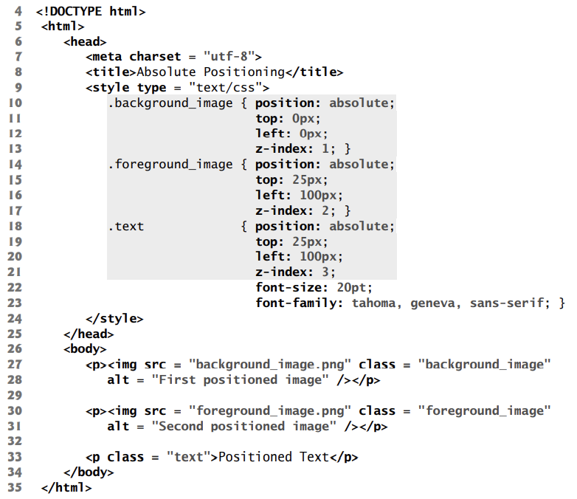
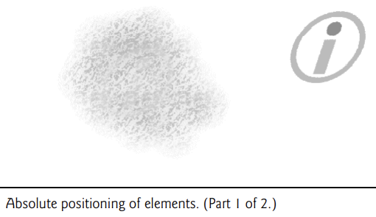
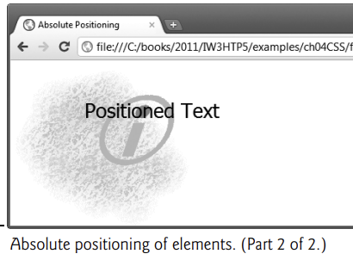

Slide 64
Positioning Elements: Absolute Positioning, z-index
The z-index property allows you to layer overlapping elements.
Elements that have higher z-index values are displayed in front of elements with lower z-index values.
In this example, .background_image has the lowest z-index (1), so it displays in the background. The .foreground_image CSS rule (lines 14–17) gives the circle image (foreground_image.png, in lines 30–31) a z-index of 2, so it displays in front of background_image.png.
The p element in line 33 is given a z-index of 3 in line 21, so its content (Positioned Text) displays in front of the other two.
If you do not specify a z-index or if elements have the same z-index value, the elements are placed from background to foreground in the order in which they’re encountered in the document.
The default z-index value is 0.

Slide 65
Positioning Elements: Relative Positioning
In relative positioning, elements are positioned relative to other elements
An element with position: relative; is positioned relative to its normal position.
Setting the top, right, bottom, and left properties of a relatively positioned element will cause it to be adjusted away from its normal position. Other content will not be adjusted to fit into any gap left by the element.
Setting the position property to relative, as in class super (lines 15–16), lays out the element on the page and offsets it by the specified top, bottom, left or right value.
relative positioning keeps elements in the general flow of elements on the page, so positioning is relative to other elements in the flow.

Slide 66
Positioning Elements: Relative Positioning
Setting the position property to relative, as in class super (lines 15–16), lays out the element on the page and offsets it by the specified top, bottom, left or right value.
Class super (lines 15–16) lays out the text at the end of the sentence as superscript, and
class sub (lines 17–18) lays out the text as subscript relative to the other text.
Class shiftleft (lines 19–20) shifts the text at the end of the sentence left and class shiftright (lines 21–22) shifts the text right

Slide 67
Span and Div
<span> and <div> are tags that let you select a group of elements and apply styles to them
<span> is an inline tag
no breaks are added before or after <span></span>
<div> is a block tag
a break is usually added by the browser before and after the <div></div> tags
The <span> tag is similar to other HTML tags,
they can be nested and they have id and class attributes
Another tag that is useful for style specifications:
<div> - Used to create document sections (or divisions) for which style can be specified

Slide 68
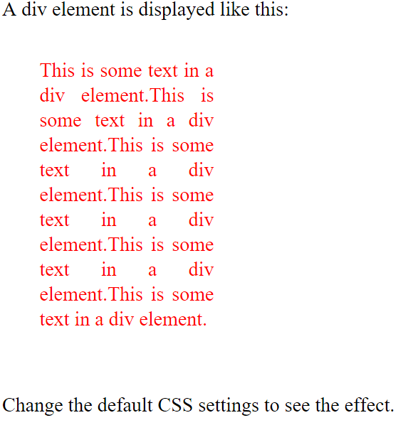
Span and Div
<html><head>
<style>
div { line-height: 20px;
margin: 30px;
padding-bottom: 20px;
text-align: justify;
width: 140px;
color: red; }
</style></head>
<body><p>A div element is displayed like this:
<div>This is some text in a div element.This is some text in a div element.This is some text in a div element.This is some text in a div element.This is some text in a div element.This is some text in a div element.</div>
Change the default CSS settings to see the effect.
</p></body></html>

Slide 69
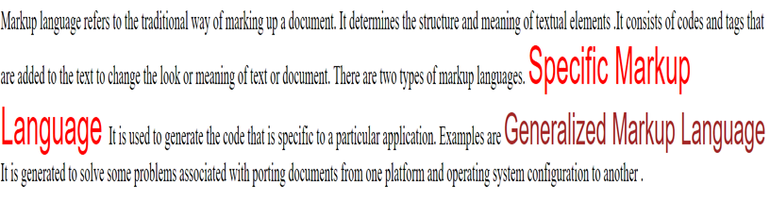
<!DOCTYPE html >
<html >
<head> <title>Selectors.html</title>
<style type="text/css">
.spanred {font-size:24pt;font-family:Arial;color:red;}
.spanbrown {font-size:20pt;font-family:Arial;color:brown;}
</style>
</head>
<body>
<p>Markup language refers to the traditional way of marking up a document. It determines the structure and meaning of textual elements . There are two types of markup languages.
<span class="spanred">Specific Markup Language </span>
It is used to generate the code that is specific to a particular application. Examples are
<span class="spanbrown">Generalized Markup Language</span>
It is generated to solve some problems associated with porting documents from one platform and operating system configuration to another</p>
</body></html>

Slide 70
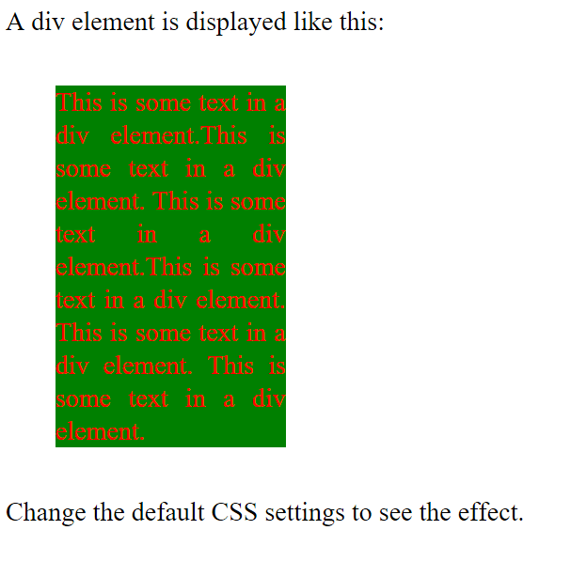
Span and Div
<html><head>
<style>
div {
line-height: 20px;
margin: 30px;
text-align: justify;
width: 140px;
color: red;
background-color:green;
}
</style></head><body><p>A div element is displayed like this:
<div>This is some text in a div element.This is some text in a div element.This is some text in a div element.This is some text in a div element.This is some text in a div element.This is some text in a div element.</div>Change the default CSS settings to see the effect.</p></body></html>

Slide 71
Differentiate between block tags and inline tags. Illustrate with suitable examples?
In HTML, elements are categorized as either block-level tags or inline tags based on how they behave in the document's structure.
A block-level element always starts on a new line and takes up the full width available
Block-level tags create a new block of content and can contain other block-level or inline elements.ex:<div>,<h1>,<ul>,<p>etc
An inline element does not start on a new line and it only takes up as much width as necessary
The <div> element is a block-level and is often used as a container for other HTML elements
The <span> element is an inline container used to mark up a part of a text, or a part of a document.ex:<span><img>,<a>,<em> etc

Slide 72
Box Model

Slide 73

Box Model
When the browser renders an element using the box model, the content is surrounded by padding, a border and a margin

Slide 74
Box model
The CSS box model is essentially a box that wraps around every HTML element. It consists of: margins, borders, padding, and the actual content.
Content - The content of the box, where text and images appear
Padding - Clears an area around the content. The amount of space between the content of an element and its border , known as padding. The padding is transparent
Border - A border that goes around the padding and content
Margin - Clears an area outside the border. The space between the border and an adjacent element known as margin. The margin is transparent
The box model allows us to add a border around elements, and to define space between elements.

Slide 75
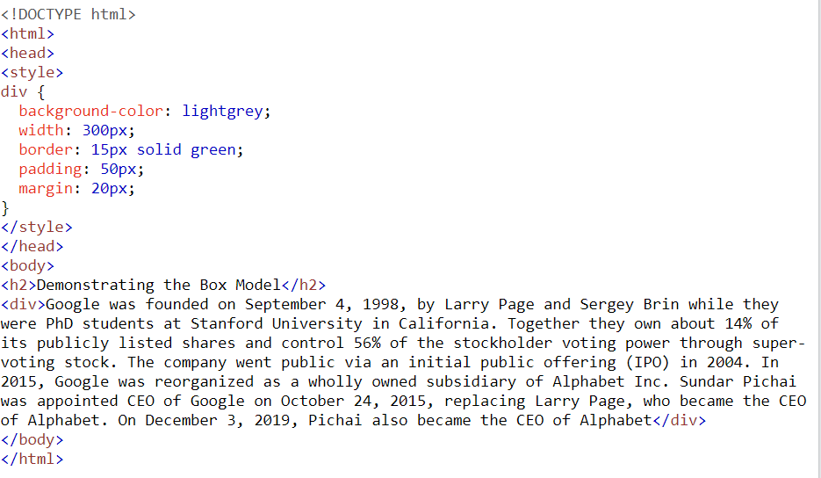

Box model

Slide 76
Box model-controlling the margin
To define the margins of an element, use:
margin : value
where value = a length value (“em” is often used), a percentage (a margin proportional to the element’s width, or auto
To set margins on a side, use:
margin-top
margin-right
margin-bottom
margin-left
E.g., body {margin-left:12px; margin-right:3%; margin-top:10px; margin-bottom:1em}
(“em” is often used), a margin proportional to the element’s width, or auto

Slide 77
Box model-setting the padding
To define padding, use:
padding: value
where value = a length value or a percentage (a padding proportional to the element’s width)
To set padding on a side, use:
padding-top
padding-right
padding-bottom
padding-left

Slide 78
Box model-formatting the border
Border can be set in three ways:
border-width(thin,thick,medium or length in pixels)
border-style (dotted,dashed,solid,double,default,none)
border-color
Short hands for setting border
Ex: border:5px solid blue ;
td,th { border:thin double black ; }
To set the border, use:
border : width_value style color
To set borders on a side, use:
border-top
border-bottom
border-left
border-right

Slide 79
Box model-formatting the border
Border can be set in three ways:
border-width(thin,thick,medium or length in pixels)
border-style (dotted,dashed,solid,double.default-none)
border-color
Short hands for setting border
Ex: border:5px solid blue ;
td,th { border:thin double black ; }
To set the border, use:
border : width_value style color
To set borders on a side, use:
border-top
border-bottom
border-left
border-right

Slide 80

Box model-formatting the border
<style type=“text/css”>
table{
padding-left:20px;
padding-right:10pt;
padding-top:3%;
padding-bottom:1%;
border-left:dotted;
border-right:double;
border-top:oblique;
border-bottom:solid;
border-width:10px;
border-color:red
}
</style>

Slide 81
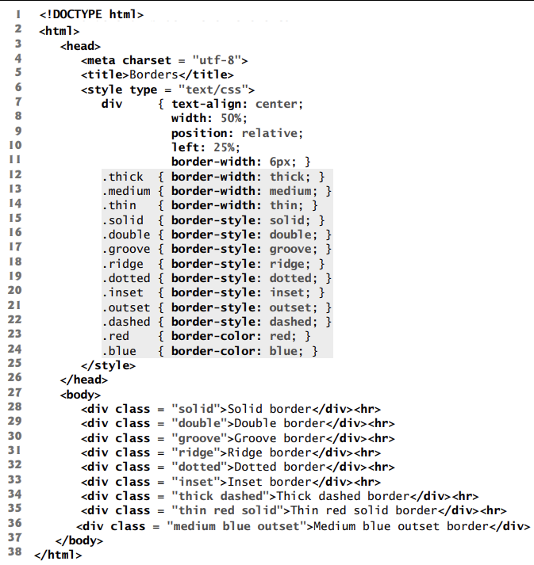
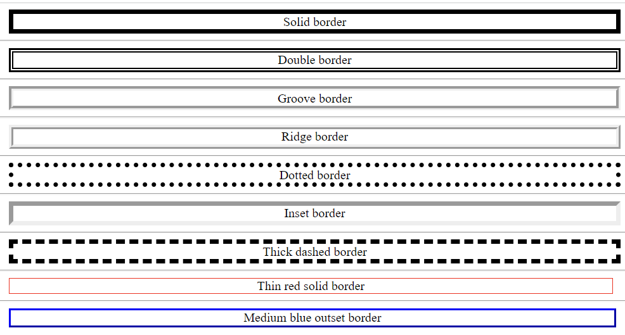

Slide 82
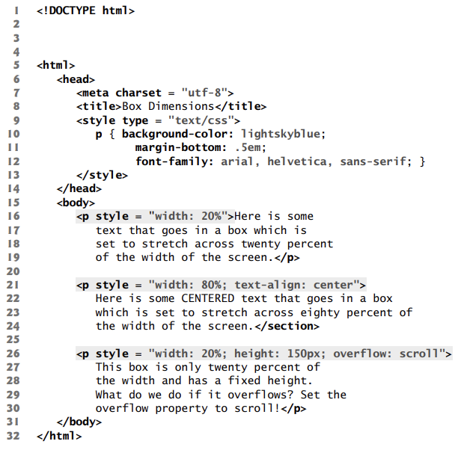
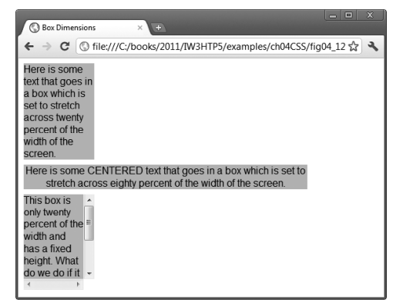
Element Dimensions
In addition to positioning elements, CSS rules can specify the actual dimensions of each element.

Slide 83
Media Types and media queries

Slide 84
Responsive web design
Responsive web design is about creating web sites which automatically adjust themselves to look good on all devices, from small phones to large desktops
Responsive web design provides an optimal experience, easy reading and easy navigation with a minimum of resizing on different devices such as desktops, mobiles and tabs).
Responsive web design makes your web page look good on all devices.
Responsive web design uses only HTML and CSS.
Web pages should not leave out information to fit smaller devices, but rather adapt its content to fit any device:
It is called responsive web design when you use CSS and HTML to resize, hide, shrink, enlarge, or move the content to make it look good on any screen.

Slide 85
Responsive web design
Breakpoints are the building blocks of responsive design. Use them to control when your layout can be adapted at a particular viewport or device size.
media queries are used to architect the CSS by breakpoint.
Media queries are a feature of CSS that allow you to conditionally apply styles based on a set of browser and operating system parameters.
We most commonly use min-width in our media queries.
Mobile first, responsive design is the goal.
Bootstrap’s CSS aims to apply the bare minimum of styles to make a layout work at the smallest breakpoint, and then layers on styles to adjust that design for larger devices.

Slide 86
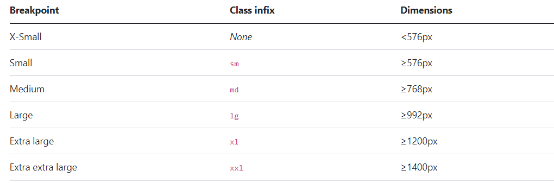
Available breakpoints
Breakpoints are the building blocks of responsive design.
media queries are used to architect the CSS by breakpoint.

Slide 87
Responsive web design

Slide 88
Media types and media queries
CSS media types allow you to decide what a page should look like, depending on the kind of media being used to display the page.
Media queries are a key part of responsive web design, as they allow you to create different layouts depending on the size of the viewport
The @media rule, introduced in CSS2, made it possible to define different style rules for different media types.
Examples: You could have one set of style rules for computer screens, one for printers, one for handheld devices, one for television-type devices, and so on.
The most common media type for a web page is the screen media type, which is a standard computer screen.
Other media types in CSS include handheld, braille, speech and print

Slide 89
Media types and media queries
The handheld medium is designed for mobile Internet devices such as smartphones, while braille is for machines that can read or print web pages in braille.
speech styles allow you to give a speech-synthesizing web browser more information about the content of a page.
The print media type affects a web page’s appearance when it’s printed.
For a complete list of CSS media types, see
Media types allow you to decide how a page should be presented on any one of these media without affecting the others
Example that applies one set of styles when the document is viewed on all media (including screens) other than a printer, and another when the document is printed.

Slide 90
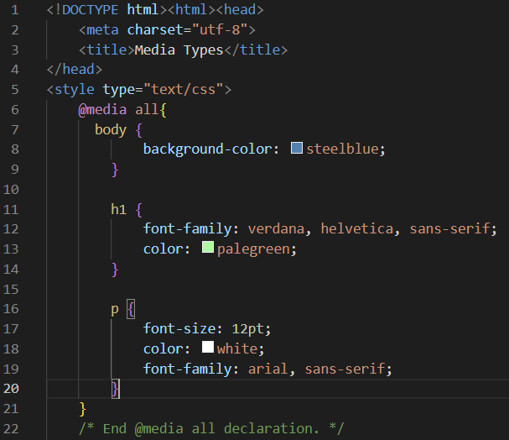
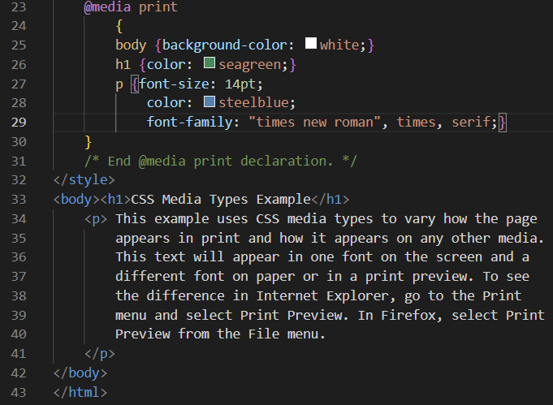

Slide 91
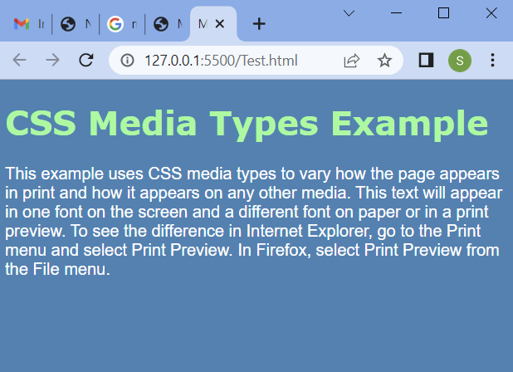
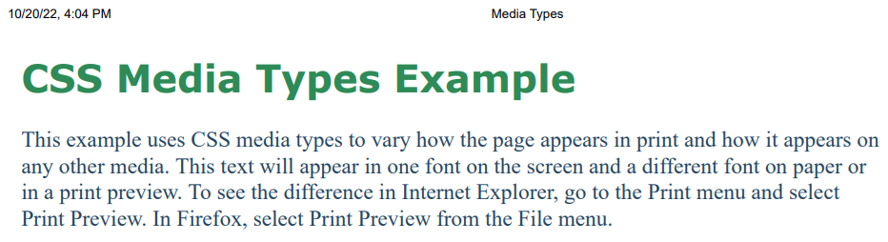

Slide 92
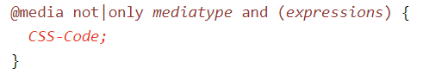
Media queries
Media query is a CSS technique introduced in CSS3.
Media queries can be used to check many things, such as:
width and height of the viewport
width and height of the device
orientation (is the tablet/phone in landscape or portrait mode?)
resolution
Using media queries is a popular technique for delivering a tailored style sheet to desktops, laptops, tablets, and mobile phones
A media query consists of a media type and can contain one or more expressions, which resolve to either true or false.
It uses the @media rule to include a block of CSS properties only if a certain condition is true.

Slide 93

Media queries
meaning of the not, only and and keywords:
not: The not keyword inverts the meaning of an entire media query.
only: The only keyword prevents older browsers that do not support media queries with media features from applying the specified styles. It has no effect on modern browsers.
and: The and keyword combines a media feature with a media type or other media features.
They are all optional. However, if you use not or only, you must also specify a media type.
Media Types are:

Slide 94

Media queries
If the browser window is 600px or smaller, the background color will be lightblue:

Slide 95

Media queries
Use mediaqueries to set the background-color to lavender if the viewport is 800 pixels wide or wider, to lightgreen if the viewport is between 400 and 799 pixels wide. If the viewport is smaller than 400 pixels, the background-color is lightblue

Slide 96
Media queries
Media queries allow you to format your content to specific output devices. Media queries include a media type and expressions.
Some of the common media features include:
width—the width of the part of the screen on which the document is rendered, including any scrollbars
height—the height of the part of the screen on which the document is rendered, including any scrollbars
device-width—the width of the screen of the output device
device-height—the height of the screen of the output device
orientation—if the height is greater than the width, orientation is portrait, and if the width is greater than the height, orientation is landscape
aspect-ratio—the ratio of width to height
device-aspect-ratio—the ratio of device-width to device-height

Slide 97
Media queries
Media queries are useful when you want to modify your site or app depending on a device's general type (such as print vs. screen) or specific characteristics and parameters (such as screen resolution or browser viewport width).
Media queries are used for the following:
To conditionally apply styles with the CSS @media and @import at-rules.
To target specific media for the <style>, <link>, <source>, and other HTML elements with the media= attribute.

Slide 98


Media queries

Slide 99



Slide 100
JAVASCRIPT

Slide 101
MODULE 2
(CSS, JavaScript) Introduction to Stylesheets : Introduction to CSS-Basic syntax and structure-Inline Styles, Embedded Style Sheets, Conflict Resolution, Linking External Style Sheets-Exploring CSS Selectors-Properties, values, Positioning Elements: Absolute Positioning, Relative Positioning - Backgrounds-List Styles-Element Dimensions- Table Layouts-Box Model and Text Flow-div and span -Basics of Responsive CSS, Media port & Media Queries.
Introduction to JavaScript : Introduction to Scripting- Programming fundamentals of JavaScript -Obtaining User Input with prompt Dialogs-Arithmetic-Decision Making -Control Statements - Functions -Arrays -Objects -Document Object Model (DOM) -Form processing

Slide 102
JAVASCRIPT
JavaScript is a scripting language, which is used to enhance the functionality and appearance of web pages
JavaScript is a Client side scripting tool
JavaScript is used in Web pages to improve the design, validate forms, detect browsers, create cookies, and much more.
JavaScript is the most popular scripting language on the internet, and works in all major browsers, such as Internet Explorer, Mozilla, Firefox, Netscape, Opera
JavaScript and Java are only related through syntax →JavaScript is dynamically typed →JavaScript’s support for objects is very different

Slide 103
Java & JAVASCRIPT
Java and JavaScript are two completely different languages in both concept and design!
Java (developed by Sun Microsystems) is a powerful and much more complex programming language - in the same category as C and C++.
Object model of javascript is quite different from java & C++
Java is strongly typed and Javascript is Dynamically typed
In Java ,types are all known at compile time, where as compile time type checking impossible
Objects in Java are static (variables or function is shared between all instances of class)where as objects are dynamic

Slide 104
Uses of JAVASCRIPT
JavaScript was designed to add interactivity to HTML
JavaScript is a scripting language
It is usually embedded directly into HTML pages
JavaScript is an interpreted language
provide programming capability at both the server and the client ends of a Web connection.
Improve appearance especially graphics
Site navigation
Perform calculations
Validation of input
DOM allows Javascript to access &modify the style

Slide 105

How to put JAVASCRIPT in HTML code?

Slide 106




Slide 107
How to embed JavaScript in an HTML document
When a JavaScript script is encountered in the HTML document, the browser uses its JavaScript interpreter to “execute” the script.
Output from the script becomes the next markup to be rendered.
When the end of the script is reached, the browser goes back to reading the HTML document and displaying its content.
There are two different ways to embed JavaScript in an HTML document:
– implicitly and explicitly.
In explicit embedding, the JavaScript code physically resides in the XHTML document.
In implicit embedding the JavaScript can be placed in its own file(.js file), separate from the XHTML document.
When JavaScript scripts are explicitly embedded, they can appear in either part of an XHTML document—the head or the body
The interpreter notes the existence of scripts that appear in the head of a document, but it does not interpret them while processing the head.
Scripts that are found in the body of a document are interpreted as they are found.

Slide 108


How to embed JavaScript in an HTML document
JavaScript are embedded in HTML documents , Either directly, as in • -
Or indirectly, as a file specified in the src attribute of

Slide 109

JavaScript “hello” example in an HTML document

Slide 110


JavaScript “hello” example in an HTML document

Slide 111
How to embed JavaScript in an HTML document
<script> tag to indicate to the browser that the text which follows is part of a script.
The type attribute specifies the MIME type of the script as well as the scripting language used in the script—in this case, a text file written in javascript. In HTML5,
the default MIME type for a <script> is "text/html", so you can omit the type attribute from your <script> tags
Individual white-space characters between words in a string are not ignored by the browser.
browsers ignore leading white-space characters (i.e., white space at the beginning of a string).
Strings in JavaScript can be enclosed in either double quotation marks (") or single quotation marks (‘)
document object, which represents the HTML5 document the browser is currently displaying. This object allows you to specify text to display in the HTML5 document.
document object’s writeln method is used to write a line of HTML5 markup in the HTML5 document.
Method writeln instructs the browser to write the argument string into the web page for rendering.
If the string contains HTML5 elements, the browser interprets these elements and renders them on the screen

Slide 112


JavaScript “hello” example with inline style

Slide 113


JavaScript example with alert

Slide 114

JavaScript example with alert-Usage of Escape Sequence
The backslash (\) in a string is an escape character.
It indicates that a “special” character is to be used in the string.
When a backslash is encountered in a string, the next character is combined with the backslash to form an escape sequence.

Slide 115
Programming fundamentals of JavaScript

Slide 116
GENERAL SYNTACTIC CHARACTERISTICS
Identifier form: begin with a letter or underscore, followed by any number of
letters, underscores, and digits
Case sensitive
25 reserved words, plus future reserved words
Comments: both // and /* … */
Scripts are usually hidden from browsers that do not include JavaScript
interpreters by putting them in special comments
<!--
-- JavaScript script –
//-->
Semicolons can be a problem. They are “somewhat” optional.
Problem : When the end of the line can be the end of a statement ,JavaScript puts a semicolon there
When separated by semicolons, multiple statements on one line are allowed: a = 5; b = 6; c = a + b;

Slide 117


JavaScript example with alert, No semicolon

Slide 118
PRIMITIVES
JavaScript provides different data types to hold different types of values.
1.Primitive Types
• five primitive types:
– Number,
– String
– Boolean,
– Undefined,
– Null
2.Non-Primitive Types
• Objects such as functions and arrays are referred to as non-primitive values.

Slide 119
PRIMITIVES
Primitive Types
five primitive types: Number, String, Boolean, Undefined, or Null
Number, String, and Boolean have wrapper objects (Number, String, and Boolean).
wrapper objects
Wrapper objects are used to provide properties and methods that are convenient to use with the values of primitive types.
Anything that doesn’t belong to any of these five primitive types is considered an object.
BUT each of these five primitive data types has a corresponding object constructor..
First as a primitive data type:
var word = "hello";
And then as an object:
var word = new String("hello");

Slide 120
PRIMITIVES and NonPrimitive Values
The fundamental difference between primitives and non-primitives is that primitives are immutable and non-primitives are mutable.
Primitives are known as being immutable data types because there is no way to change a primitive value once it gets created.
var s = 'This is a string.’;
s[1] = ‘H’;
alert(s) // 'This is a string.’
Non-primitive values are mutable data types.
The value of an object can be changed after it gets created.
var arr = [ 'one', 'two', 'three', 'four', 'five’ ];
arr[1] = 'TWO’;
alert(arr) // [ 'one', 'TWO', 'three', 'four', 'five' ];

Slide 121
Numeric & String Literals,Other Primitives
Numeric & String Literals
Numeric literals – like Java All numeric values are stored in double-precision floating point 72,7.2,.72,7E2,7e2 etc are valid
String literals are delimited by either ' or "
Can include escape sequences (e.g., \t)
All String literals are primitive values
Other Primitive Types
Boolean values are true and false.Used for evaluating Boolean Expressions
The only Null value is null-means no value variable has not been explicitly declared or assigned a value.
The only Undefined value is undefined-variable has been explicitly declared, but not assigned a value
A variable declared without a value will have the value undefined. ex)var carName;

Slide 122
Declaring variables
JavaScript is dynamically typed – any variable can be used for anything
The interpreter determines the type of a particular occurrence of a variable
Keywords are words that have special meaning in JavaScript.
The keyword var at the beginning of the statement indicates that the word name is a variable.
A variable is a location in the computer’s memory where a value can be stored for use by a script.
All variables have a name and value, and should be declared with a var statement before they’re used in a script.
Variables can be implicitly or explicitly declared
var sum =0,today ="Monday", flag = false; var counter;
Variable names are case sensitive , They must begin with a letter or the underscore character

Slide 123
Identifiers and Case Sensitivity
The name of a variable can be any valid identifier.
An identifier is a series of characters consisting of letters, digits, underscores ( _ ) and dollar signs ($) that does not begin with a digit and is not a reserved JavaScript keyword.
Identifiers may not contain spaces.
Some valid identifiers are Welcome, $value, _value, m_inputField1 and button7.
The name 7button is not a valid identifier, because it begins with a digit, and the name ‘input field’ is not valid, because it contains a space.
Remember that JavaScript is case sensitive—uppercase and lowercase letters are considered to be different characters, so name, Name and NAME are different identifiers.

Slide 124
Obtaining User Input with prompt Dialogs

Slide 125
Obtaining User Input with prompt Dialogs
Scripting gives you the ability to generate part or all of a web page’s content at the time it’s shown to the user.
A script can adapt the content based on input from the user or other variables, such as the time of day or the type of browser used by the client. Such web pages are said to be dynamic, as opposed to static, since their content has the ability to change.
The script uses another predefined dialog box from the window object—a prompt dialog—which allows the user to enter a value that the script can use
The JavaScript model for the HTML document is the Document object
The model for the browser display window is the Window object
The Document object has a method, write, which dynamically creates content
The parameter is a string, often catenated from parts, some of which are variables e.g., document.write("Answer: " + result );
The Window object has three methods for creating dialog boxes, alert, confirm, & prompt

Slide 126



Obtaining User Input with prompt Dialogs
prompt("What is your name?", "");
Opens a dialog box and displays its string parameter, along with a text box and two buttons, OK and Cancel
An empty string is returned for the default input
Null will be returned if we press the cancel button

Slide 127



Obtaining User Input with prompt Dialogs

Slide 128
Operators

Slide 129

Arithmetic Operators

Slide 130


Arithmetic Operators

Slide 131

Arithmetic Operators

Slide 132
Operator Precedence
JavaScript applies the operators in arithmetic expressions uses the following rules of operator precedence
Multiplication, division and remainder operations are applied first. If an expression contains several multiplication, division and remainder operations, operators are applied from left to right.
Multiplication, division and remainder operations are said to have the same level of precedence.
Addition and subtraction operations are applied next. If an expression contains several addition and subtraction operations, operators are applied from left to right.
Addition and subtraction operations have the same level of precedence.

Slide 133

Assignment Operators

Slide 134

Assignment Operators

Slide 135

Comparison Operators

Slide 136

Logical Operators

Slide 137

Logical Operators
The && operator has a higher precedence than the || operator.
Both operators associate from left to right. An expression containing && or || operators is evaluated only until truth or falsity is known.
the || operator immediately returns true if the first operand is true. This performance feature for evaluation of logical AND and logical OR expressions is called short-circuit evaluation.

Slide 138
String Concatenation Operator
JavaScript has a version of the + operator for string concatenation that enables a string and a value of another data type (including another string) to be combined. The result of this operation is a new (and normally longer) string
String catenation operator +
txt1 = “Ben";
txt2 = “Alex";
txt3 = txt1 + " " + txt2;
o/p→ Ben Alex
txt1 = "What a very ";
txt1 += "nice day";
o/p→What a very nice day

Slide 139
String Concatenation Operator
the + operator used for string concatenation can convert other variable types to strings if necessary.
Because string concatenation occurs between two strings, JavaScript must convert other variable types to strings before it can proceed with the operation.
For example, if a variable age has an integer value equal to 21, then the expression "my age is " + age evaluates to the string "my age is 21".
JavaScript converts the value of age to a string and concatenates it with the existing string literal "my age is ".

Slide 140
Creating and Using a New Date Object
Create one with the new operator & Date constructor (no params)
Local time methods of Date:
toLocaleString– returns a string of the date
getDate – returns the day of the month
getMonth – returns the month of the year (0 – 11)
getDay – returns the day of the week (0 – 6)
getFullYear– returns the year
getTime – returns the number of milliseconds since January 1, 1970
getHours – returns the hour (0 – 23)
getMinutes– returns the minutes (0 – 59)
getMilliseconds– returns the milliseconds (0 – 999)

Slide 141


Creating and Using a New Date Object

Slide 142



Creating and Using a New Date Object
<script type="text/javascript">
var today = new Date();
alert(today);
alert(today.getDate());
alert(today.getMonth());
alert(today.getDay());
alert(today.getFullYear());
alert(today.getTime())
</script>

Slide 143

Sum of two numbers

Slide 144



Sum of two numbers

Slide 145

Sum of two numbers

Slide 146

Memory Concepts
Variable names such as number1, number2 and sum actually correspond to locations in the computer’s memory.
Every variable has a name, a type and a value
Suppose the user entered the string 45 as the value for firstNumber. The script converts firstNumber to an integer, and the computer places the integer value 45 into location number1
Whenever a value is placed in a
memory location, the value replaces
the previous value in that location.
The previous value is lost.

Slide 147

Memory Concepts
Once the script has obtained values for number1 and number2, it adds the values and places the sum into variable sum.
JavaScript does not require variables to have a declared type before they can be used in a script.
A variable in JavaScript can contain a value of any data type, and in many situations JavaScript automatically converts between values of different types for you.
For this reason, JavaScript is
referred to as a loosely typed
language

Slide 148
Memory Concepts
Unlike its predecessor languages C, C++ and Java, JavaScript does not require variables to have a declared type before they can be used in a script
When a variable is declared in JavaScript, but is not given a value, the variable has an undefined value.
Attempting to use the value of such a variable is normally a logic error.
When variables are declared, they’re not assigned values unless you specify them.
Assigning the value null to a variable indicates that it does not contain a value.

Slide 149
String properties and Methods
String properties & methods:
length e.g., var len = str1.length;
var str=“George”;
var len = str1.length; //len→6
charAt(position) e.g., str.charAt(3) //r
indexOf(string) e.g., str.indexOf(‘o’) //2
substring(from, to) e.g., str.substring(2,4) //org
toLowerCase() e.g., str.toLowerCase() //george

Slide 150






String properties and Methods

Slide 151

Precedence and Associativity

Slide 152
Control Statements

Slide 153

Control statement

Slide 154
Decision Making

Slide 155
Conditional statement
if statement - use this statement if you want to execute some code only if a specified condition is true
if...else statement - use this statement if you want to execute some code if the condition is true and another code if the condition is false
if...else if....else statement - use this statement if you want to select one of many blocks of code to be executed
switch statement - use this statement if you want to select one of many blocks of code to be executed .

Slide 156
Conditional statement
if (condition)
{
code to be executed if condition is true
}
JavaScript’s if statement that allows a script to make a decision based on the truth or falsity of a condition.
If the condition is met (i.e., the condition is true), the statement in the body of the if statement is executed.
If the condition is not met (i.e., the condition is false), the statement in the body of the if statement is not executed.
conditions in if statements can be formed by using the equality operators and relational operators

Slide 157

Equality & Relational Operators

Slide 158
Conditional statement
if (condition)
{
code to be executed if condition is true
}
JavaScript’s if statement that allows a script to make a decision based on the truth or falsity of a condition.
If the condition is met (i.e., the condition is true), the statement in the body of the if statement is executed.
If the condition is not met (i.e., the condition is false), the statement in the body of the if statement is not executed.
conditions in if statements can be formed by using the equality operators and relational operators

Slide 159




IF statement

Slide 160
IF ELSE
if (condition)
{ code to be executed if condition is true
}
else
{ code to be executed if condition is not true
}
JavaScript’s if statement that allows a script to make a decision based on the truth or falsity of a condition.
If the condition is met (i.e., the condition is true), the statement in the body of the if statement is executed.
If the condition is not met (i.e., the condition is false), the statement in the body of the else block is executed.

Slide 161





IF ELSE

Slide 162
ELSE IF STATEMENT
Use the else if statement to specify a new condition if the first condition is false.
Syntax
if (condition1)
{ block of code to be executed if condition1 is true }
else if (condition2)
{ block of code to be executed if the condition1 is false and condition2 is true }
else
{ block of code to be executed if the condition1 is false and condition2 is false }

Slide 163
Conditional Operator (?:)
JavaScript provides an operator, called the conditional operator (?:), that’s closely related to the if…else statement.
The operator ?: is JavaScript’s only ternary operator—it takes three operands. The operands together with the ?: form a conditional expression.
The first operand is a Boolean expression, the second is the value for the conditional expression if the expression evaluates to true and the third is the value for the conditional expression if the expression evaluates to false.
document.writeln( studentGrade >= 60 ? "Passed" : "Failed" );
A conditional expression that evaluates to the string "Passed" if the condition studentGrade >= 60 is true and evaluates to the string "Failed" if the condition is false

Slide 164




ELSE IF STATEMENT

Slide 165


Nested if else

Slide 166

Nested if else

Slide 167
Switch statements
Use the switch statement to select one of many blocks of code to be executed. Syntax switch(expression)
{ case 1: code block
break; …………
case n: code block
break;
default: code block
}
The switch expression is evaluated once.
The value of the expression is compared with the values of each case.
If there is a match, the associated block of code is executed

Slide 168

Switch statements

Slide 169


Switch statements

Slide 170


Switch statements

Slide 171

Switch statements

Slide 172
Loop Statements

Slide 173
Loop statements
Different Kinds of Loops
JavaScript supports different kinds of loops:
for - loops through a block of code a number of times
For a loop, when you execute a loop for a fixed number of times, the loop does three specified tasks (Statement 1, Statement 2, Statement 3)
for/in - loops through the properties of an object
while - loops through a block of code while a specified condition is true
do/while - also loops through a block of code while a specified condition is true
It will execute at least once even if the condition is to be not satisfied. If the condition is true, it will continue executing and once the condition becomes false, it stops the code execution.

Slide 174
For Loop statements
for (statement 1; statement 2; statement 3)
{
code block to be executed
}
Statement 1 is executed before the loop (the code block) starts.
Statement 2 defines the condition for running the loop (the code block).
Statement 3 is executed each time after the loop (the code block) has been executed. Example
for (i = 0; i < 5; i++)
{
text += "The number is " + i + "";
alert(text);
}

Slide 175

Examples using For Loop statements

Slide 176


Examples using For Loop statements

Slide 177
For..in statements
The JavaScript for/in statement loops through the properties of an object:
Example
<script type=“text/javascript”>
var x;
var cars =["Maruthi","Toyoto", "BMW"];
for (x in cars)
{
alert(x+ "="+ cars[x]);
}
</script>

Slide 178
While loop statements
The while loop loops through a block of code as long as a specified condition is true. while (condition)
{ code block to be executed }
<script type="text/javascript">
var i=0;
while (i < 10)
{
alert("i="+i);
i++;
}
</script>

Slide 179


While loop statements

Slide 180


Do ..While loop statements
The do/while loop is a variant of the while loop.
This loop will execute the code block once, before checking if the condition is true, then it will repeat the loop as long as the condition is true.
Syntax
do
{ code block to be executed
}
while (condition);

Slide 181

Break statements
The break statement "jumps out" of a loop.
It was used to "jump out" of a switch() statement
break statement also be used to jump out of a loop.
The break statement breaks the loop and continues executing the code after the loop (if any):
Example

Slide 182

continue statement
The continue statement "jumps over" one iteration in the loop.
The continue statement breaks one iteration (in the loop), if a specified condition occurs, and continues with the next iteration in the loop.
This example skips the value of 3

Slide 183
Tutorial Questions
A palindrome is a number or a text phrase that reads the same backward and forward. For example, each of the following five-digit integers is a palindrome: 12321, 55555, 45554 and 11611. Write a script that reads in a five-digit integer and determines whether it’s a palindrome. If the number is not five digits long, display an alert dialog indicating the problem to the user. Allow the user to enter a new value after dismissing the alert dialog.
Develop a script that will determine the gross pay for each of three employees. The company pays “straight time” for the first 40 hours worked by each employee and pays “time and a half” for all hours worked in excess of 40 hours. You’re given a list of the employees of the company, the number of hours each employee worked last week and the hourly rate of each employee. Your script should input this information for each employee, determine the employee’s gross pay and output HTML5 text that displays the employee’s gross pay. Use prompt dialogs to input the data.

Slide 184

Tutorial Questions
Write a script that uses looping to print the following table of values. Output the results in an HTML5 table. Use CSS to center the data in each column.

Slide 185

Tutorial Questions
Predict the output??

Slide 186
Functions

Slide 187
Functions
function function_name([formal_parameters])
{ -- body – }
Return value is the parameter of return ,If there is no return, or if the end of the function is reached, undefined is returned .If return has no parameter, undefined is returned
Function call -Functions are invoked by writing the name of the function, followed by a left parenthesis, followed by a comma-separated list of zero or more arguments, followed by a right parenthesis
If fun is the name of a function,
var a=fun();
or
fun(); /* A call to fun */

Slide 188

Functions-example

Slide 189
Functions
The parameter values that appear in a call to a function are called actual parameters.
The parameter names that appear in the header of a function definition, which correspond to the actual parameters in calls to the function, are called formal parameters.
JavaScript uses the pass-by-value parameter-passing method.
When a function is called, the values of the actual parameters specified in the call are copied into their corresponding formal parameters, which behave exactly like local variables.

Slide 190



Functions

Slide 191

Functions

Slide 192

Functions

Slide 193
Functions
Scripts can also be placed in external files:
External file:// myScript.js
function test()
{
document.getElementById("demo").innerHTML = “welcome to Javascript.";
}
External scripts are practical when the same code is used in many different web pages.
JavaScript files have the file extension .js.
To use an external script, put the name of the script file in the src (source) attribute of a <script> tag and embed in the html doc:
<script src="myScript.js"></script>

Slide 194

Compute the roots of a quadratic equation -example

Slide 195

Example-Maximum of three numbers using user defined function

Slide 196
Example-Random Number Generation
Consider the following statement:
var randomValue = Math.random();
Method random generates a floating-point value from 0.0 up to, but not including, 1.0.
If random truly produces values at random, then every value in that range has an equal chance (or probability) of being chosen each time random is called.
Math.floor determine the closest integer not greater than the argument’s value—for example, Math.floor(1.75) is 1 and Math.floor(6.75) is 6
Math.floor( 1 + Math.random() * 6 )
The preceding expression multiplies the result of a call to Math.random() by 6 to produce a value from 0.0 up to, but not including, 6.0. This is called scaling the range of the random numbers.

Slide 197


Example-Random Number Generation

Slide 198


Example-Linear search

Slide 199
Global functions
JavaScript provides several standard global functions that are commonly used in programming.
These functions are part of the global JavaScript object and can be used without the need for importing or including additional libraries
The Global object contains all the global variables in the script, all the user-defined functions in the script, and all the functions.
Because global functions and user-defined functions are part of the Global object, some JavaScript programmers refer to these functions as methods.
You do not need to use the Global object directly—JavaScript references it for you

Slide 200
Global functions
parseInt(): Converts a string to an integer and returns the integer value.
parseFloat(): Converts a string to a floating-point number and returns the number.
isNaN(): Checks if a value is NaN (Not-a-Number).
isFinite(): Checks if a value is a finite number.
decodeURI() and encodeURI(): These functions are used for decoding and encoding Uniform Resource Identifiers (URIs), respectively.
decodeURIComponent() and encodeURIComponent(): These functions are used for decoding and encoding URI components.
eval(): Evaluates a string as JavaScript code.
alert(), prompt(), and confirm(): Functions for interacting with the user via pop-up dialog boxes.

Slide 201

Global functions

Slide 202


Slide 203
Recursion
A recursive function is a function that calls itself, either directly, or indirectly through another function.
The recursion step executes while the original call to the function is still open (i.e., it has not finished executing).
The recursion step can result in many more recursive calls as the function divides each new subproblem into two conceptual pieces.
For the recursion eventually to terminate, each time the function calls itself with a simpler version of the original problem, the sequence of smaller and smaller problems must converge on the base case.

Slide 204

Recursive Function -Factorial

Slide 205



Recursive Function -Factorial
var and let create variables that can be reassigned to another value. Const creates “constant” variables that cannot be reassigned to another value

Slide 206
Recursion Vs Iteration
Both iteration and recursion are based on a control statement:
Iteration uses a repetition statement (e.g., for, while or do…while);
recursion uses a selection statement (e.g., if, if…else or switch).
Both iteration and recursion involve repetition:
Iteration explicitly uses a repetition statement;
recursion achieves repetition through repeated function calls.
Iteration and recursion each involve a termination test:
Iteration terminates when the loop-continuation condition fails;
recursion terminates when a base case is recognized.
Both iteration and recursion can occur infinitely:
An infinite loop occurs with iteration if the loop-continuation test never becomes false;
infinite recursion occurs if the recursion step does not reduce the problem each time via a sequence that converges on the base case or if the base case is incorrect.

Slide 207
ARRAYS

Slide 208
ARRAYS
Arrays are data structures consisting of related data items.
JavaScript arrays are “dynamic” entities in that they can change size after they’re created.
An array is a group of memory locations that all have the same name and normally are of the same type (although this attribute is not required in JavaScript).
To refer to a particular location or element in the array, we specify the name of the array and the position number of the particular element in the array
The first element in every array is the zeroth element.
Thus, the first element of array c is referred to as c[0], the second element as c[1].
The position number in square brackets is called an index and must be an integer or an integer expression.
If a program uses an expression as an index, then the expression is evaluated to determine the value of the index.

Slide 209
ARRAYS
JavaScript arrays are used to store multiple values in a single variable.
Syntax: var array_name = [item1, item2, ...];
Example: var cars = [“Maruthi",“Toyoto","BMW"];
An array can hold many values under a single name,
Access the values of array by referring to an index number.
we can create a JavaScript Array Using an array literal.
Syntax: var array_name = new Array(item1, item2, ….);
The following example also creates an Array, and assigns values to it:
Example
var s = new Array(“AA", ”BB",“CC”);
var list = new Array(2, 4, 6, 8);

Slide 210
ARRAYS
var n = [ 10, 20, 30, 40, 50 ];
Uses a comma-separated initializer list enclosed in square brackets ([ and ]) to create a five element array with indices of 0, 1, 2, 3 and 4.
The array size is determined by the number of values in the initializer list.
var n = new Array( 10, 20, 30, 40, 50 );
Also creates a five-element array with indices of 0, 1, 2, 3 and 4.
In this case, the initial values of the array elements are specified as arguments in the parentheses following new Array.
The size of the array is determined by the number of values in parentheses
var n = [ 10, 20, , 40, 50 ];
creates a five-element array in which the third element (n[2]) has the value undefined

Slide 211

Accessing elements of ARRAYS
An array element can be accessed by referring to the index number.
To access the value of the first element in s:
var name = s[0];
<script>
var s = ["AA", "BB", "CC"];
alert(s[2]+" "+s[1]+" "+s[0]);
</script>
The length property of an array returns the length of an array (the number of array elements). Ex)
var s = new Array(“AA", ”BB",“CC”);
alert(s.length);
//return 3

Slide 212


Example of function and array

Slide 213

ARRAY properties and methods
Adding Array Elements
To add a new element to an array is using the push method: •
s.push(“XX");

Slide 214

ARRAY properties and methods
Adding Array Elements
New element can also be added to an array using the length property:
var s = ["BB", "OO", "AA", "MM"];
s[s.length] = "LL"; //add as last element
Adding elements with high indexes can create undefined "holes" in an array:
var s = ["BB", "OO", "AA", "MM"];
s[6] = "PP“

Slide 215
ARRAY properties and methods
Popping Array Elements
The pop() method removes the last element from an array:
Example
var s = ["AA", "BB", "CC"];
s.pop();
// Removes the last element (“CC") from array s
The pop() method returns the value that was "popped out":
Example
var s = ["BB","OO","AA",“MM"];
var x = s.pop();
// the value of x is "MM"

Slide 216
ARRAY properties and methods
Shifting is equivalent to popping, working on the first element instead of the last.
The shift() method removes the first array element and "shifts" all other elements to a lower index.
Example
var s = ["BB", "OO", "AA", “MM"];
s.shift();
// Removes the first element "BB" from ‘ s’
The shift() method returns the string that was "shifted out":
Example
var s = ["BB", "OO", "AA", “MM"];
alert(s.shift()); //dislays "BB"

Slide 217

ARRAY properties and methods
The unshift() method adds a new element to an array (at the beginning), and "unshifts" older elements:
Example
var s = ["BB", "OO", "AA", “MM"];
s.unshift(“PP"); // Adds a new element “PP" to s
The unshift() method returns the new array length.
Example
var s = ["BB", "OO", "AA", “MM"];
alert(s.unshift(“PP");
// Returns 5

Slide 218
ARRAY properties and methods
Deleting Elements
Since JavaScript arrays are objects, elements can be deleted by using the JavaScript operator delete:
Example
var s = ["BB", "OO", "AA",“MM"];
delete s[0];
// Changes the first element in s to undefined
Using delete may leave undefined holes in the array. Use pop() or shift() instead.

Slide 219
ARRAY properties and methods
Splicing an Array
The splice() method can be used to add new items to an array:
Example
var fruits = ["Banana","Orange", "Apple", "Mango"];
fruits.splice(2, 0, "Lemon", "Kiwi");
The first parameter (2) defines the position where new elements should be added (spliced in).
The second parameter (0) defines how many elements should be removed.
The rest of the parameters ("Lemon" , "Kiwi") define the new elements to be added.

Slide 220

ARRAY properties and methods

Slide 221
ARRAY properties and methods
Merging an Array
concat() method creates a new array by merging (concatenating) existing arrays:
Example (Merging Two Arrays)
var girls = [“ammu",“annu"];
var boys = ["Emil",“richu","Linu"];
var mystds = girls.concat(boys); //Concatenates (joins) girls and boys
The concat() method does not change the existing arrays. It always returns a new array.The concat() method can take any number of array arguments:
Example (Merging Three Arrays)
var arr1 = ["cilie","Lona"]; var arr2 = ["Emil","Tobias","Linus"]; var arr3 = ["Robin","Morgan"];
var myChildren = arr1.concat(arr2, arr3); // Concatenates arr1 with arr2 and arr3

Slide 222
ARRAY properties and methods
The concat() method can also take values as arguments:
Example (Merging an Array with Values)
var arr1 = ["Cecilie", "Lone"];
var myChildren = arr1.concat(["Emil", "asi", "Linu"]);
slice() method slices out a piece of an array into a new array.
slices out a part of an array starting from array element 1 ("Orange"):
var fruits = ["Banana", "Orange", "Lemon", "Apple", "Mango"];
var citrus = fruits.slice(1);
slice() method creates a new array. It does not remove any elements from the source array.

Slide 223
ARRAY properties and methods
This example slices out a part of an array starting from array element 3 ("Apple"):
var fruits = ["Banana","Orange","Lemon","Apple","Mango"];
var citrus = fruits.slice(3);
The slice() method can take two arguments like slice(1, 3).
The method then selects elements from the start argument, and up to (but not including) the end argument.
var fruits = ["Banana","Orange","Lemon","Apple","Mango"];
var citrus = fruits.slice(1,3);
The sort() method sorts an array alphabetically:
var fruits = ["Banana","Orange","Apple","Mango"];
fruits.sort();
// Sorts the elements of fruits

Slide 224
ARRAY properties and methods
Numeric Sort
By default, the sort() function sorts values as strings.
This works well for strings .
However, if numbers are sorted as strings, "25" is bigger than "100", because "2" is bigger than "1".
Because of this, the sort() method will produce incorrect result when sorting numbers
Use compare function for numeric sorting.
A function that defines an alternative sort order. • The function should return a negative, zero, or positive value, depending on the arguments, like: function(a, b)
{
return a-b;
}

Slide 225

ARRAY properties and methods
When the sort() method compares two values, it sends the values to the compare function , and sorts the values according to the returned (negative, zero, positive) value.
Example:
When comparing 40 and 100, the sort() method calls the compare function(40,100).The function calculates 40-100, and returns -60 (a negative value).The sort function will sort 40 as a value lower than 100.

Slide 226
Reverse Arrays
The reverse() method reverses the elements in an array.
use it to sort an array in descending order:
var fruits = ["Banana", "Orange", "Apple","Mango"];
fruits.sort();
// Sorts the elements of fruits
fruits.reverse();
// Reverses the order of the elements

Slide 227
Associate Arrays
Arrays with named indexes are called associative arrays (or hashes).
JavaScript does not support arrays with named indexes.
In JavaScript,arrays always use numbered indexes.
Example
var person = [];
person[0] = "John";
person[1] = "Doe";
person[2] = 46;
var x = person.length;
// person.length will return 3
var y = person[0];
// person[0] will return "John"

Slide 228
Associate Arrays
If you use named indexes, JavaScript will redefine the array to a standard object.
After that, some array methods and properties will produce incorrect results.
Example:
var person = [];
person["firstName"] = "John";
person["lastName"] = "Doe";
person["age"] = 46;
var x = person.length;
// person.length will return 0
var y = person[0];
// person[0] will return undefined

Slide 229
Multi Dimensional Arrays
Multidimensional arrays with two indices are often used to represent tables of values consisting of information arranged in rows and columns
Arrays that require two indices to identify a particular element are called two-dimensional arrays.
Multidimensional arrays can have more than two dimensions.
JavaScript does not support multidimensional arrays directly, but it does allow you to specify arrays whose elements are also arrays.
An array with m rows and n columns is called an m-by-n array.

Slide 230

Multi Dimensional Arrays
Every element in array a is identified by an element name of the form a[row][column]—a is the name of the array, and row and column are the indices that uniquely identify the row and column, respectively, of each element in a.
The element names in row 0 all have a first index of 0; the element names in column 3 all have a second index of 3.

Slide 231
Arrays of One dimensional Arrays
Multidimensional arrays can be initialized in declarations like a one-dimensional array. Array b with two rows and two columns could be declared and initialized with the statement .Two-dimensional array with three rows and four columns.
The values are grouped by row in square brackets.
The array [1, 2] initializes element b[0], and the array [3, 4] initializes element b[1]. So 1 and 2 initialize b[0][0] and b[0][1], respectively. Similarly, 3 and 4 initialize b[1][0] and b[1][1], respectively.
interpreter determines the number of rows by counting the number of subinitializer lists— arrays nested within the outermost array. The interpreter determines the number of columns in each row by counting the number of values in the subarray that initializes the

Slide 232
Two-Dimensional Arrays with Rows of Different Lengths and new
The rows of a two-dimensional array can vary in length. The declaration var b = [ [ 1, 2 ], [ 3, 4, 5 ] ];
creates array b with row 0 containing two elements (1 and 2) and row 1 containing three elements (3, 4 and 5).
Creating Two-Dimensional Arrays with new
A multidimensional array in which each row has a different number of columns can be allocated dynamically, as follows:
var b;
b = new Array( 2 ); // allocate two rows
b[ 0 ] = new Array( 5 ); // allocate columns for row 0
b[ 1 ] = new Array( 3 ); // allocate columns for row 1
The preceding code creates a two-dimensional array with two rows. Row 0 has five columns, and row 1 has three columns.

Slide 233


Two-Dimensional Arrays with Rows of Different Lengths and new

Slide 234
OBJECTS

Slide 235
OBJECTS
In JavaScript, objects are a fundamental data type that allow you to store and manipulate data in a structured way.
Almost "everything" is an object.
Booleans can be objects (if defined with the new keyword)
Numbers can be objects (if defined with the new keyword)
Strings can be objects (if defined with the new keyword)
Dates are always objects
Maths are always objects
Regular expressions are always objects
Arrays are always objects
Functions are always objects
All JavaScript values, except primitives, are objects.

Slide 236

OBJECTS

Slide 237
OBJECTS
With JavaScript, you can define and create your own objects.
There are different ways to create new objects:
1)Define and create a single object, using an object literal.
2)Define and create a single object, with the keyword new.
JavaScript objects are written with curly braces. Object properties are written as name:value pairs, separated by commas.
The following example creates a new JavaScript object with four properties:
var person = {firstName:“xyz”, lastName:“pqr", age:50, eyeColor:"blue"};
The object (person) in the example above has 4 properties: firstName, lastName, age, and eyeColor.
A JavaScript object is a collection of named values
The named values, in JavaScript objects, are called properties.

Slide 238
OBJECT Creation using new
The following example also creates a new JavaScript object with four properties:
Properties are the values associated with a JavaScript object.
A JavaScript object is a collection of unordered properties.
Properties can usually be changed, added, and deleted, but some are read only
Example
var person = new Object();
person.firstName = “xyz";
person.lastName = “pqr";
person.age = 50;
person.eyeColor = "blue";

Slide 239
OBJECT Creation using new
The following example also creates a new JavaScript object with four properties:
Properties are the values associated with a JavaScript object.
A JavaScript object is a collection of unordered properties.
Properties can usually be changed, added, and deleted, but some are read only
Example
var person = new Object();
person.firstName = “xyz";
person.lastName = “pqr";
person.age = 50;
person.eyeColor = "blue";

Slide 240
Add new OBJECT properties & Accessing OBJECT properties
You can add new properties to an existing object by simply giving it a value.
Assume that the person object already exists - you can then give it new properties:
Example person.city = ”kochi";
syntax for accessing the property of an object is:
objectName.property ----- person.age
or
objectName["property"] -----person["age"]
or
objectName[expression] ------- x = "age"; person[x]

Slide 241
Accessing OBJECT properties
person.firstname + " is " + person.age + " years old.";
or
person["firstname"] + " is " + person["age"] + " years old.";
The JavaScript for...in statement loops through the properties of an object.
Syntax
for (variable in object)
{
code to be executed
}
The block of code inside of the for...in loop will be executed once for each property.

Slide 242



Looping through the OBJECT
JavaScript for...in Loop
Looping through the properties of an object:
Example

Slide 243
Delete the properties of OBJECT
The delete keyword deletes a property from an object:
Example
var person = {fname:“xyz", lname:“pqr", age:50, city:“kochi"};
delete person.age;
or
delete person["age"];
The delete keyword deletes both the value of the property and the property itself.
After deletion, the property cannot be used before it is added back again.
The delete operator is designed to be used on object properties.
It has no effect on variables or functions

Slide 244
STRINGS, NUMBERS, AND BOOLEANS AS OBJECTS
When a JavaScript variable is declared with the keyword "new", the variable is created as an object:
var x = new String();
// Declares x as a String object
var y = new Number();
// Declares y as a Number object
var z = new Boolean();
// Declares z as a Boolean object
Avoid String, Number, and Boolean objects.

Slide 245

Math Object methods

Slide 246

Math Object methods

Slide 247

Math Object methods

Slide 248

String Object methods

Slide 249

String Object methods

Slide 250

String Object methods

Slide 251

String Object methods

Slide 252

Character processing methods
String object’s character-processing methods, including:
charAt—returns the character at a specific position
charCodeAt—returns the Unicode value of the character at a specific position
fromCharCode—returns a string created from a series of Unicode values
toLowerCase—returns the lowercase version of a string
toUpperCase—returns the uppercase version of a string

Slide 253

Character processing methods

Slide 254

Character processing methods

Slide 255

Date Object Methods

Slide 256

Date Object Methods

Slide 257
Date Object Methods

Slide 258

Date Object Methods

Slide 259

Date Object Methods

Slide 260

Boolean and Number Objects
JavaScript provides the Boolean and Number objects as object wrappers for boolean true/ false values and numbers, respectively.
These wrappers define methods and properties useful in manipulating boolean values and numbers.
When a JavaScript program requires a boolean value, JavaScript automatically creates a Boolean object to store the value.
var b = new Boolean( booleanValue );
The booleanValue specifies whether the Boolean object should contain true or false.
If booleanValue is false, 0, null, Number.NaN or an empty string (""), or if no argument is supplied, the new Boolean object contains false.

Slide 261
Boolean and Number Objects
JavaScript automatically creates Number objects to store numeric values in a script. You can create a Number object with the statement
var n = new Number( numericValue );
The constructor argument numericValue is the number to store in the object.
We can explicitly create Number objects, normally the JavaScript interpreter creates them as needed

Slide 262

Boolean and Number Objects

Slide 263

Document Objects
The document object, which is provided by the browser and allows JavaScript code to manipulate the current document in the browser.
The document object has several properties and methods, such as method document.getElementByID

Slide 264
DOCUMENT OBJECT MODEL
The W3C Document Object Model (DOM) is a platform and language-neutral interface that allows programs and scripts to dynamically access and update the content, structure, and style of a document."

Slide 265
DOM
DOM is a model for describing HTML documents
A common set of properties/methods to access everything in a web document
When a web page is loaded, the browser creates a Document Object Model of the page.
The HTML DOM model is constructed as a tree of Objects:
Objects are in a hierarchy
The window is the parent for a given web page
Document is the child with the objects that are most commonly manipulated
The HTML DOM is a standard for how to get, change, add, or delete HTML elements.
HTML DOM methods are actions you can perform (on HTML Elements).
HTML DOM properties are values (of HTML Elements) that you can set or change.

Slide 266
Document Object Model
The DOM gives you scripting access to all the elements on a web page.
Inside the browser, the whole web page—paragraphs, forms, tables, etc.—is represented in an object hierarchy.
Using DOM, we can dynamically create, modify, and remove elements on the page.
JavaScript can change all the HTML elements on the page
JavaScript can change all the HTML attributes on the page
JavaScript can change all the CSS styles on the page
JavaScript can remove existing HTML elements and attributes
JavaScript can add new HTML elements and attributes
JavaScript can react to all existing HTML events on the page
JavaScript can create new HTML events on the page

Slide 267
DOM nodes and Trees
The document’s getElementById method is the simplest way to access a specific element in a page. The method returns objects called DOM nodes.
Every piece of an HTML5 page (elements, attributes, text, etc.) is modeled in the web browser by a DOM node.
All the nodes in a document make up the page’s DOM tree, which describes the relationships among elements.
Nodes are related to each other through child-parent relationships.
An HTML5 element inside another element is said to be its child—the containing element is known as the parent.
A node can have multiple children but only one parent.
Nodes with the same parent node are referred to as siblings.

Slide 268

DOM nodes and Trees
The head and body nodes are siblings since they’re both children of the html node.
The head contains the meta and title nodes
The body node contains nodes representing each of the elements in the document’s body element.
The li nodes are children of the ul node since they’re nested inside it.

Slide 269


Slide 270


DOM nodes and Trees

Slide 271

FINDING & CHANGING HTML ELEMENTS

Slide 272

ADDING AND DELETING HTML ELEMENTS

Slide 273
CHANGING THE VALUE OF AN ATTRIBUTE
To change the value of an HTML attribute, use this syntax:
document.getElementById(id).attribute = new value
<!DOCTYPE html>
<html><body>
<img id=“clg“ src=“sjc.jpg">
<script>
document.getElementById(“clg").src =“sjclogo.jpg";
</script>
</body>
</html>

Slide 274
CHANGING THE HTML Style
To change the style of an HTML element, use this syntax:
document.getElementById(id).style.property = new style
<html>
<body>
<p id="p1">Hello World!</p>
<script>
document.getElementById("p1").style.color = "blue";
</script>
<p>The paragraph above was changed by a script.</p>
</body>
</html>

Slide 275
DOM EVENTS
HTML DOM allows JavaScript to react to HTML events:
JavaScript can execute a statement (typically, call a function)
A JavaScript can be executed when an event occurs, like when a user clicks on an HTML element.
To execute code when a user clicks on an element, add JavaScript code to an HTML event attribute:
when an event occurs
<… oneventname="javascript stmt;">
<BODY … onload="func();">
<INPUT type="submit“ name=“submit” onsubmit="fun();">

Slide 276
DOM EVENTS
onsubmit - call when submit button is clicked
onclick - call when this button is clicked
onreset - call when the reset button is clicked
onload - call after page loads
onmouseover - call when mouse pointer enters image area
onmouseout - call when mouse pointer leaves image area
onfocus - call when control receives focus
onblur - call when a control loses focus
onchange - call when a control loses focus and the value of its contents has changed
many more

Slide 277

DOM EVENTS

Slide 278

DOM EVENTS

Slide 279



Event handling using DOM –onclick and onMouseover

Slide 280


Event handling using DOM –onload()

Slide 281


Form Handling –onclick event

Slide 282


Form Handling –onclick event

Slide 283


Form Handling –onchange event

Slide 284

Form Handling –onchange event

Slide 285
Node in DOM
Any element on a page including text & whitespaces of a DOM structure is known as “NODE.”
Nodes can be between HTML Tags.
Nodes available in DOM:
node.childNodes
node.firstChild
node.lastChild
node.parentNode
node.nextSibling
node.previousSibling

Slide 286


Adding and Removing Nodes (HTML Elements) in DOM
To add a new element to the HTML DOM, you must create the element (element node) first, and then append it to an existing element.

Slide 287
Adding and Removing Nodes (HTML Elements) in DOM
This code creates a new <p> element:
const para = document.createElement("p");
To add text to the <p> element, you must create a text node first. This code creates a text node: const node = document.createTextNode("This is a new paragraph.");
Then you must append the text node to the <p> element:
para.appendChild(node);
Finally you must append the new element to an existing element.This code finds an existing element:
const element = document.getElementById("div1");
This code appends the new element to the existing element:
element.appendChild(para);

Slide 288


Insert before in Node
This code appends the new element to the existing element:
element.appendChild(para);

Slide 289


Remove element in Node

Slide 290


Replacing child element in Node

Slide 291
DOM Collection
The Document Object Model contains several collections, which are groups of related objects on a page.
DOM collections are accessed as properties of DOM objects such as the document object or a DOM node.
The document object has properties containing the
images collection
links collection
forms collection
anchors collection
These collections contain all the elements of the corresponding type on the page

Slide 292


DOM Collection

Slide 293

DOM Collection

Slide 294


DOM Collection

Slide 295
Thank You

